Slide 1
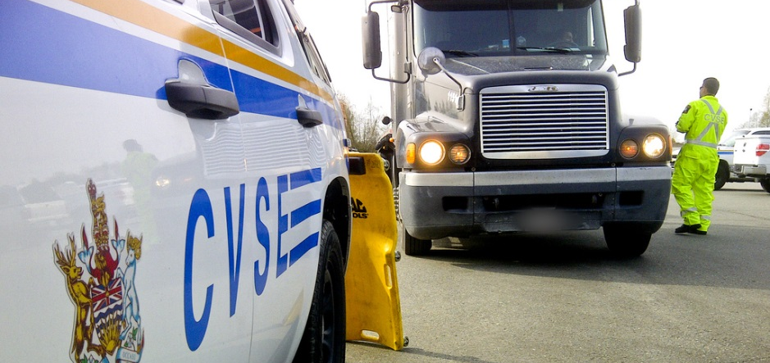
MELT Class 1 Driver Training Hours of Service
Notes:
Instructor notes:

Slide 2
Lesson overview
On-duty and off duty time
Daily limits and cycles
Deferring off duty time
Sleeper berth time
Personal use exemptions
Logbooks
Operating with 160 km of home terminal
Driving into the U.S.
Emergency and adverse conditions
Electronic log devices (ELDs)
Notes:
Instructor notes:
Provide overview of topics covered.

Slide 3
Issues of compliance
In your groups, read through and discuss the crash scenarios provided.
Scenario discussion questions:
Do you think the sentencing was fair?
Are you aware of truck drivers doctoring log books or being asked to by an employer?
Notes:
After the activity review slides 4, 5 and 6.

Slide 4
Tampering
Illegal
Companies responsibility
Driver responsible to sign and confirm all is accurate
Could be a out of service penalty
Notes:
Instructor notes:
It is against the law to tamper with a daily log. Tampering with the daily log includes any of the following activities:
Driver keeps more than one daily log for any day.
Driver records inaccurate information in a daily log, whether it is handwritten or produced using an electronic device.
Anyone falsifies, mutilates or defaces a daily log or supporting documents.
Safety officer or any other individual alters or tampers with original daily logs.
According to Section 86(2) of the Commercial Vehicle Drivers Hours of Service Regulations (SOR/2005-313) a carrier is responsible for ensuring their drivers do not falsify their logs.
Daily logs must be signed at the end of each day to confirm that all of the information recorded in a daily log is accurate. If a log contains false information, a peace officer can still charge a driver with a violation even if the driver has not signed the daily log. They may also issue an out- of-service declaration for any of the violations listed above.

Slide 5
Penalties
Convictions
$5,000.00
$25,000.00
Notes:
Instructor notes:
According to the Motor Vehicle Act 18(1), every person who contravenes or fails to comply with any provision of this Act or any regulation or order made under this Act is guilty of an offence punishable on summary conviction. Individuals who are convicted of an offence under this Act are liable to a fine not exceeding five thousand dollars. Corporations who are convicted of an offence under this Act are liable to a fine not exceeding twenty-five thousand dollars.

Slide 6
Out of service violations
Peace officers
Can be pulled off the road
Administrative penalties
Notes:
Peace officers can issue tickets to drivers on the road if hours of service records cannot be produced by the driver.
Drivers who exceed the hours of service limitation may be prohibited from driving until they have enough hours to drive again.
Administrative penalties can also be enforced for not following hours of service laws.

Slide 7
Hours of service time restrictions On-duty time
On-duty time is the period when you begin work or when a carrier requires you to be ready to start work.
On-duty time ends when you stop work.
Notes:
Instructor notes:
You’re on duty whenever you drive or when you’re:
inspecting, servicing, repairing, conditioning or starting a commercial vehicle
travelling as one of two drivers when you’re not resting in the sleeper berth
participating in the loading or unloading of a commercial vehicle
inspecting or checking the load
waiting for the vehicle or load to be checked at a customs office, weigh scale or by a peace officer
waiting along the route because of a crash or other unanticipated event
travelling as a passenger to a destination where you’ll start driving — this qualifies as on-duty time when two conditions apply:
the carrier requests you make the trip, and
you didn’t have eight consecutive hours of off-duty time immediately before you began your driving time
performing any other work as a carrier or while employed by a carrier
waiting for a commercial vehicle to be serviced, loaded or unloaded, when a carrier, who employs or otherwise engages you, asks you to do so.

Slide 8
Off-duty time
It’s important that you get enough rest every day.
Off-duty regulations protect you and everyone else who shares the road with you.
Notes:
Instructor notes:
Off-duty time includes any time you spend in a sleeper berth in a commercial vehicle.
All drivers must take a minimum of 10 hours off duty every day.
Off-duty time other than the mandatory eight consecutive hours may be distributed throughout the day in blocks of 30 minutes or more.
The total amount of off-duty time that you take in a day must include at least two hours of off-duty time that does not form part of a period of eight consecutive hours of off-duty time.
All drivers must take 24 consecutive hours off duty every 14 days.

Slide 9
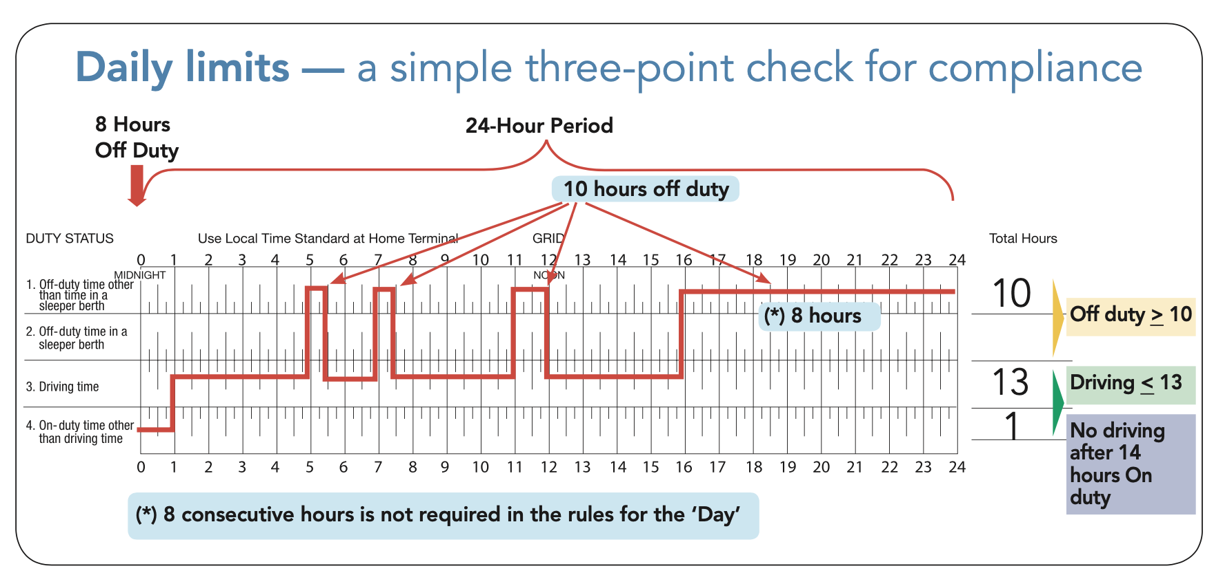
Daily limits
(Image source: ICBC Drive Commercial Vehicle Manual)
Notes:
Instructor notes:
A “day” is a 24-hour period that begins at the hour designated by the carrier for the duration of the driver’s cycle.
For example, one driver’s day might start at midnight while another driver’s day might start at 2:00am.
The driver needs to record the hour at which the day begins on their logbook page (for example, midnight or 2:00 am).
Each ‘day’ is independent and there are certain on-duty, off-duty and driving limits for each day.
A minimum of 10 hours of off-duty time must be taken every day.
You’re allowed to drive a maximum of 13 hours in a day.
You’re not allowed to drive after 14 hours on duty in a day.

Slide 10
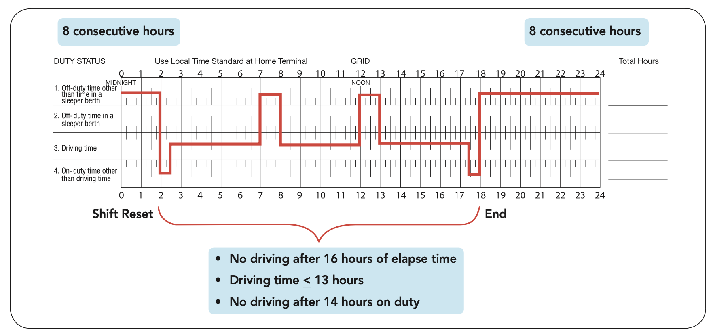
Work shift
(Image source: ICBC Drive Commercial Vehicle Manual)
Notes:
Instructor notes:
A work shift is the elapsed time between two off-duty periods of at least eight consecutive hours.
You’re not permitted to drive after 16 hours of elapsed time until you take at least eight consecutive hours of off-duty time.
Every off-duty period consisting of eight consecutive hours or more resets the work shift.

Slide 11
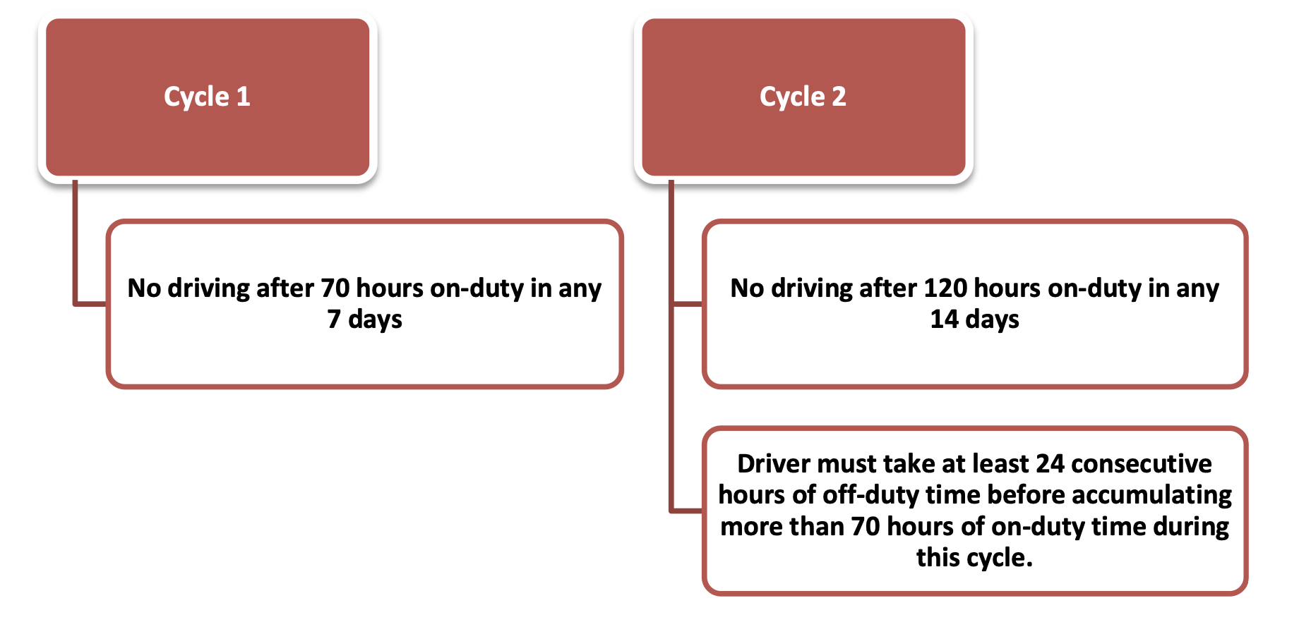
Daily hours (cycles)
Notes:
Instructor notes:
You must keep track of your time using one of two cycles. Each cycle has a maximum number of on-duty hours. You may choose one of two cycles:
Cycle 1 — Drivers working on this cycle must not drive after completing 70 on-duty hours in seven days.
Cycle 2 — Drivers working on this cycle must not drive after completing 120 hours in 14 days, and must take at least 24 consecutive hours off duty prior to accumulating 70 hours of on-duty time.
The start time remains the same throughout each cycle. You must “reset” a cycle to change the start time.
Did you know?
You can put in 14 hours of on-duty time without doing any driving at all.
You can reset a cycle at any time by taking:
36 consecutive hours off duty to reset cycle 1
72 consecutive hours off duty to reset cycle 2.

Slide 12
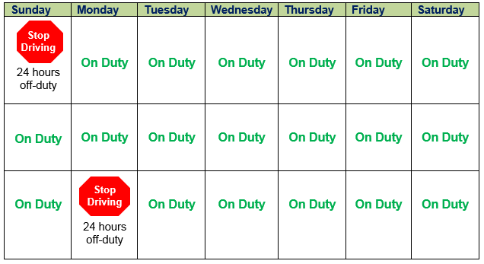
Mandatory 24 hours off-duty
Notes:
Instructor notes:
According to Section 25, a driver may not drive unless they have taken at least 24 consecutive hours of off-duty time in the preceding 14 days.
This rule applies regardless of whether a driver follows Cycle 1 or 2.
A driver is only in violation of the mandatory 24 hours off duty if the driver is driving after reaching the 14-day limit.
The driver may continue to work without having a 24-hour period of off-duty time in the preceding 14 days as long as that work does not involve driving an NSC regulated vehicle.

Slide 13
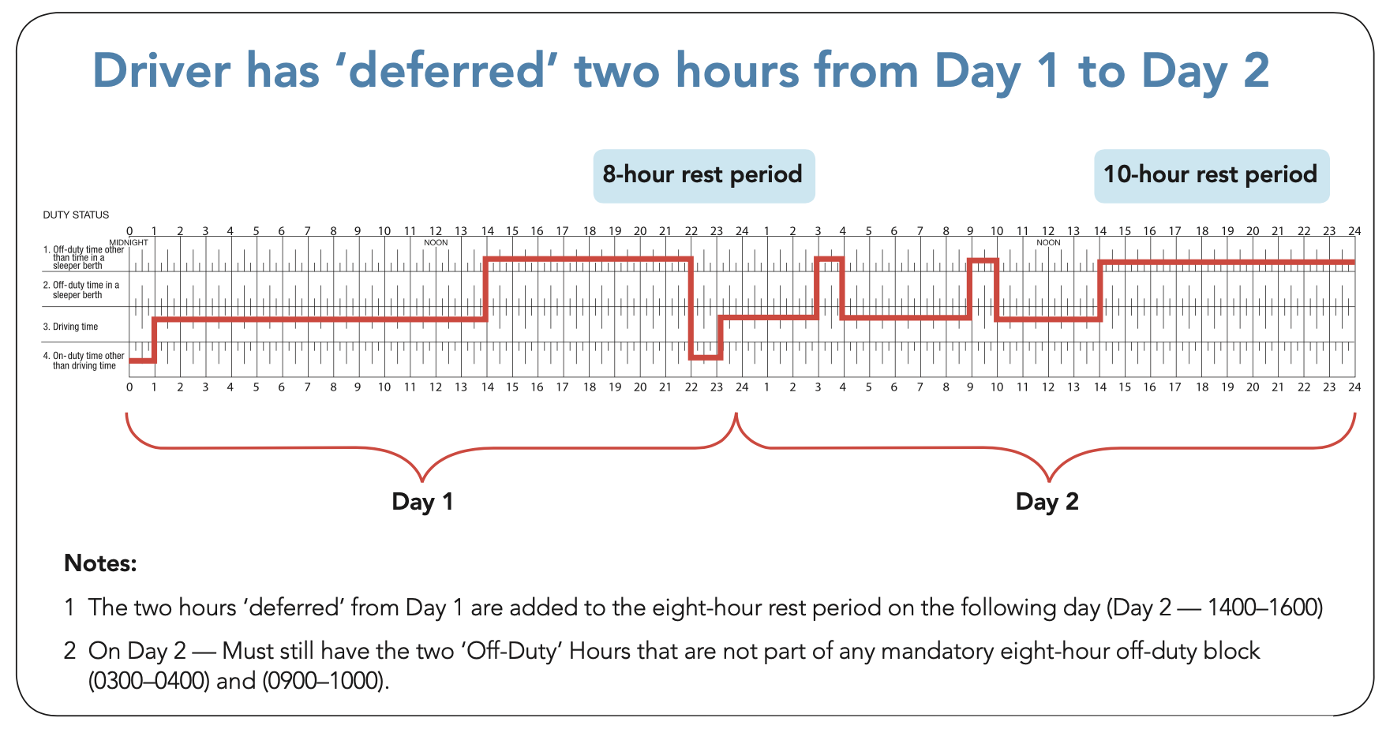
Deferring off-time duty
(Image source: ICBC Drive Commercial Vehicle Manual)
Notes:
Instructor notes:
You may reduce your off-duty requirement of 10 hours by up to two hours providing:
the two hours are not part of your eight consecutive off-duty hours
the two hours are added to the eight consecutive off-duty hours taken off the next day, and
you clearly indicate ‘Day 1’ and ‘Day 2’ on your logbook.
Reset provision You can reset a cycle at any time by taking:
36 consecutive hours off to reset Cycle 1
72 consecutive hours off to reset Cycle 2.

Slide 14
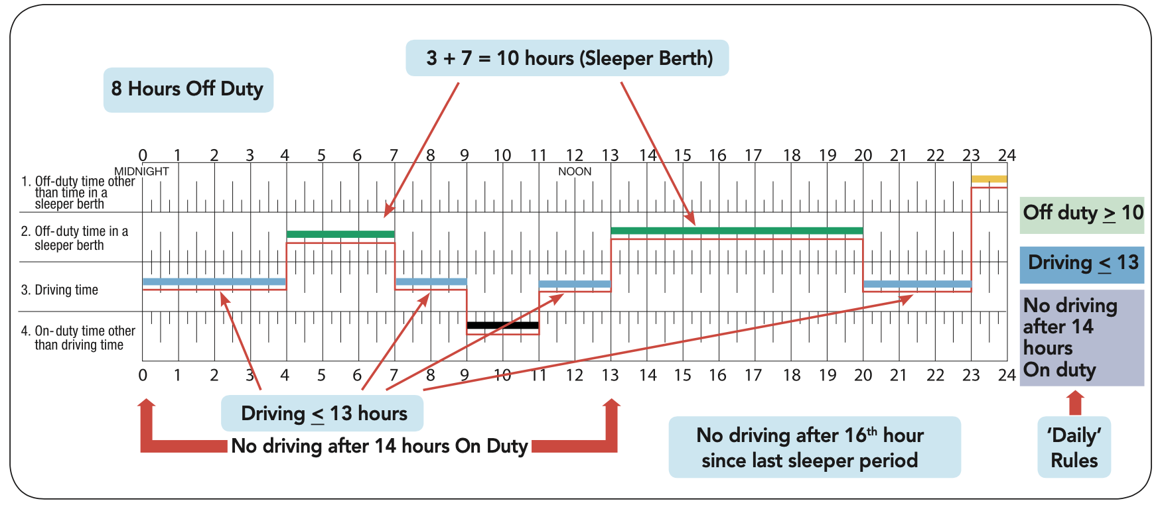
Sleeper berth (single driver)
A logbook for a single driver using a sleeper berth.
(Image source: ICBC Drive Commercial Vehicle Manual)
Notes:
Instructor notes:
With an approved sleeper berth, a driver can stop and rest whenever they are tired or during any extended period of waiting.
Record any time spent resting in a sleeper berth as “Off-Duty Time in a Sleeper Berth” on the daily log.
Can use a sleeper berth to split the required 8 consecutive off-duty hours into 2 periods while still complying with the daily off-duty requirements.
The same hours of service regulations for driving and on-duty time apply to drivers using sleeper berths.
Single driver - can split the required 10 hours of daily off- duty time into 2 sleeper berth periods if:
Neither period is less than 2 hours; the total of the 2 sleeper periods is at least 10 hours;
The off-duty time is spent resting in the sleeper berth; the total off-duty time in the day is at least 10 hours;
Total driving time in the periods immediately before and after each of the periods of off-duty time does not exceed 13 hours;
The elapsed time before and after each sleeper period does not include any driving time after the 16th hour after the driver comes on-duty;
None of the daily off-duty time is deferred to the next day.

Slide 15
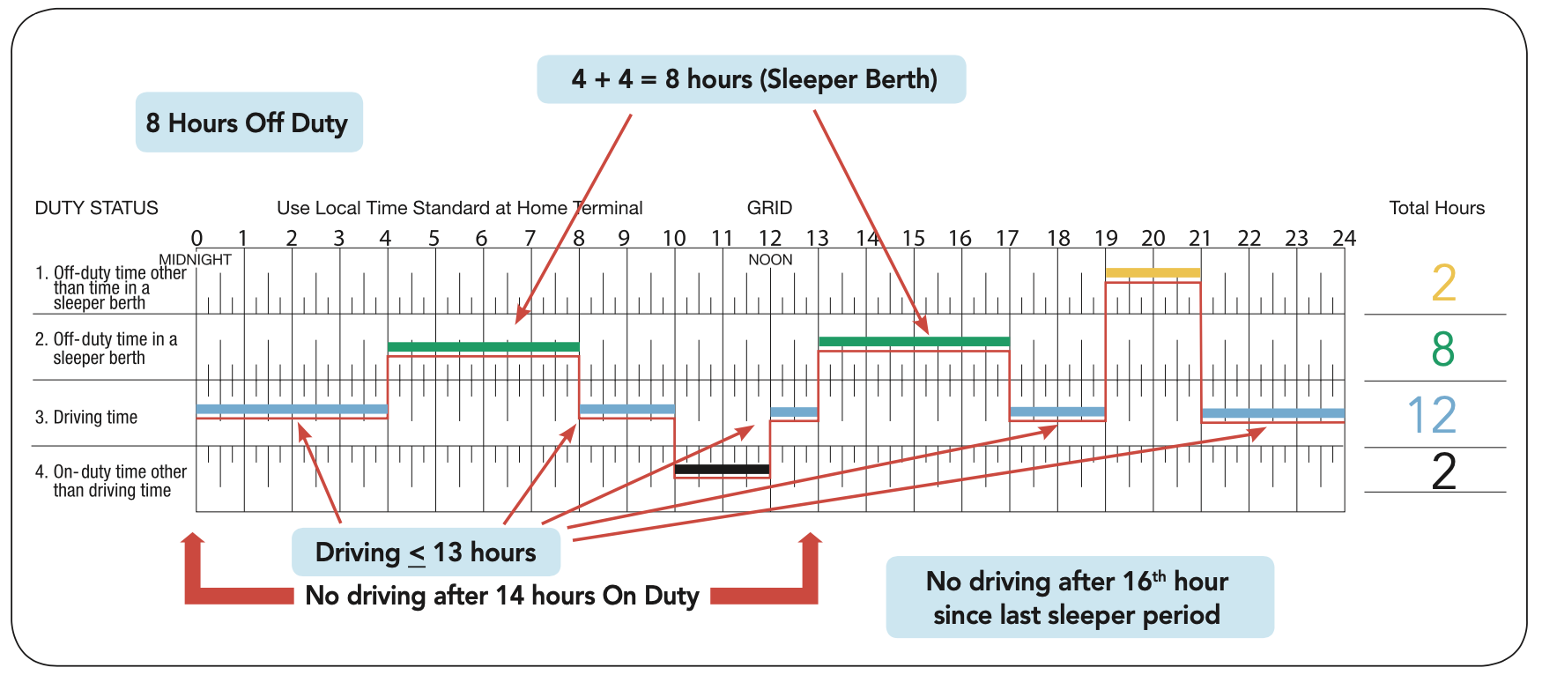
Sleeper berth (team)
A logbook for a team using a sleeper berth.
(Image source: ICBC Drive Commercial Vehicle Manual)
Notes:
Instructor notes:
Team drivers can split the required 10 hours of daily off-duty time into 2 sleeper berth periods if:
neither period is less than four hours
the total of the 2 sleeper periods is at least 8 hours
the off-duty time is spent resting in the sleeper berth
the total driving time before and after each sleeper period does not exceed 13 hours
the total of the on-duty time before and after each sleeper period does not include any driving time after the 14th hour
the elapsed time before and after each sleeper period does not include any driving time after the 16th hour after the driver comes on-duty
none of the daily off-duty time is deferred to the next day.
Co-drivers have the freedom to split the 10 hours of daily off-duty time in any way that the drivers want as long as each sleeper berth period is at least 4 hours and the total for 2 sleeper berth periods equals at least 8 hours.
Team drivers must maintain their own daily logs and must meet the daily and work shift limits on their own. When one driver is driving, the other must be resting in the sleeper berth.
Only time spent in the sleeper berth counts towards the sleeper berth period. This means that any other off-duty time, such as sitting in the passenger seat, does not count towards the sleeper berth period.

Slide 16
Personal use exemption
Not on duty if:
the vehicle’s unloaded,
the vehicle’s not towing a trailer,
the vehicle’s driven a maximum of 75 km a day for personal use,
the odometer readings are recorded, and
you’re not subject to an out-of-service declaration.
Notes:
Instructor notes:
Driving a commercial vehicle for personal use is not considered to be on-duty time if:
the vehicle is unloaded
the vehicle’s not towing a trailer
the vehicle’s driven a maximum of 75 km a day for personal use
the odometer readings are recorded, and
you’re not subject to an out-of-service declaration.

Slide 17
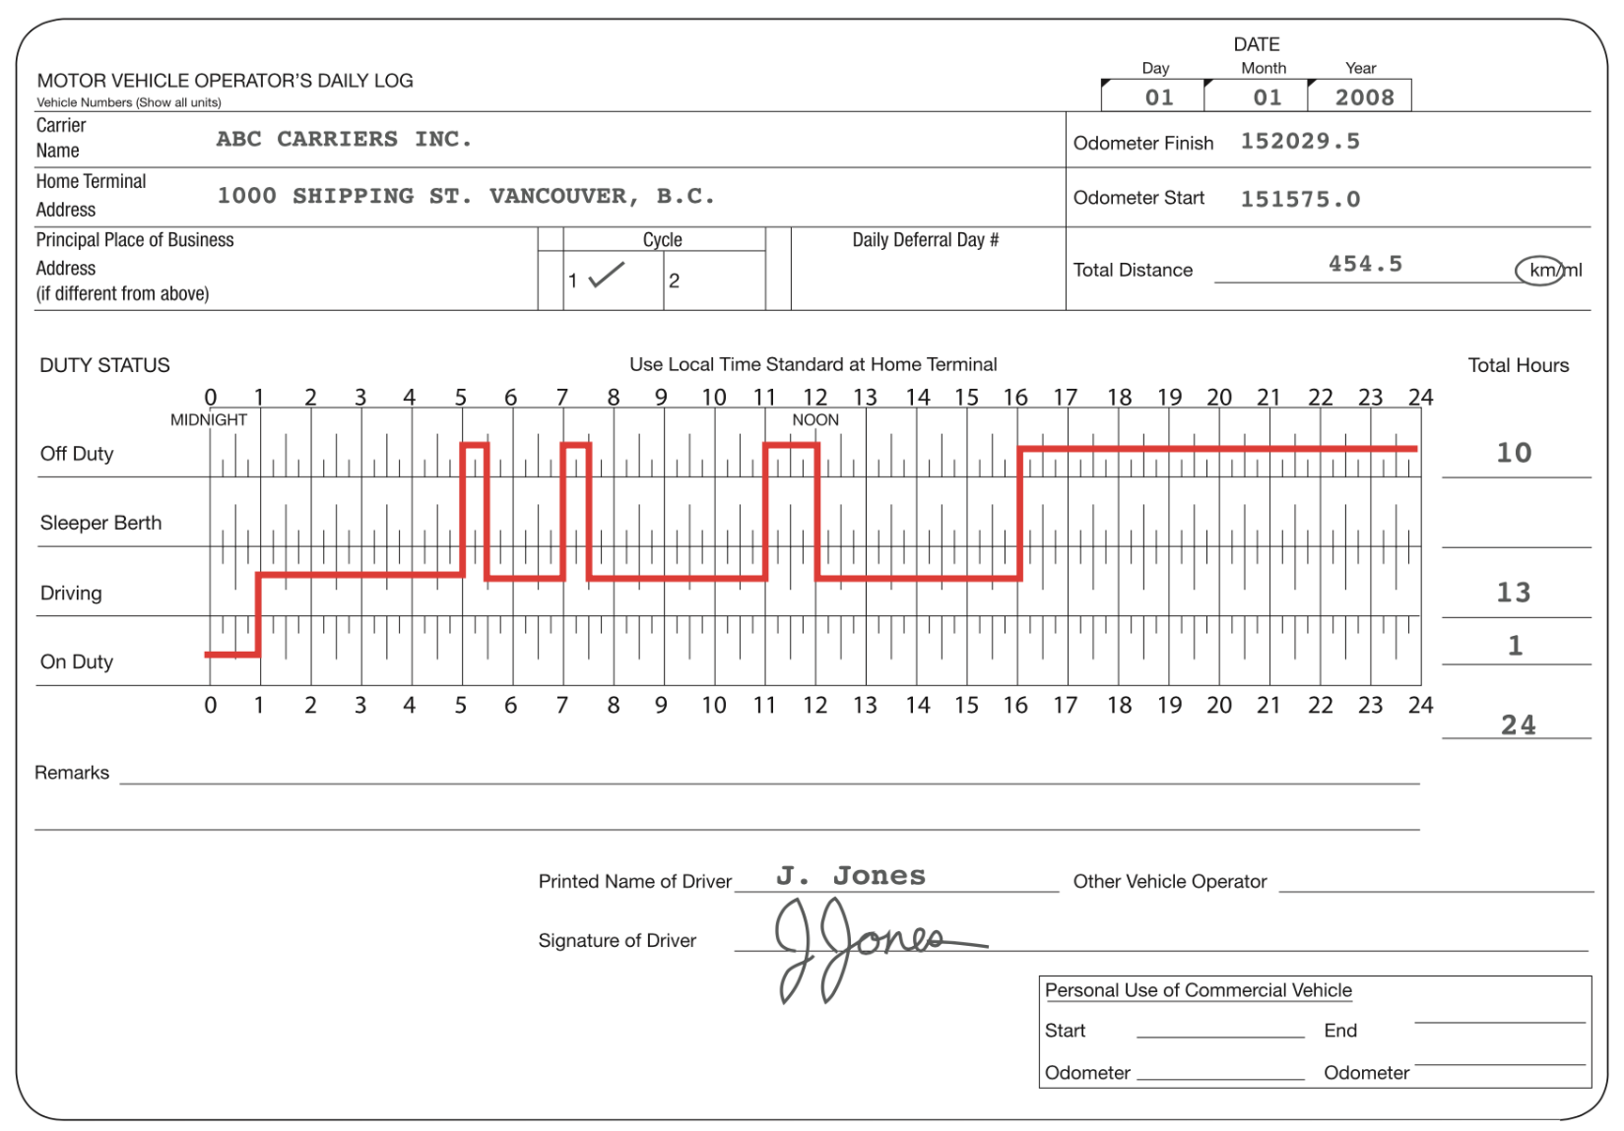
Logbooks
(Image source: ICBC Drive Commercial Vehicle Manual)
Notes:
Instructor notes:
Used to record your hours of on-duty, driving and off-duty time.
Logbook data must be completed on a graph grid so that each piece of required information may be recorded accurately.
Review what information is required on the logbook – see student guide.

Slide 18
Filling out logbooks
https://www.youtube.com/watch?v=iHZKNIpF5G4
YouTube video
A basic introduction to filling out log books (8:04)
Notes:
Instructor notes:
Watch video

Slide 19
Logbook activity
Complete your assigned logbook activities
Notes:
Instructor notes:

Slide 20
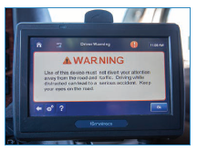
Electronic Logging Devices (EDLs)
Notes:
Review current information about ELDs. See CVSE website: cvse.ca.

Slide 21
Drivers operating within 160 km of home terminal
You aren’t required to keep logbooks if:
you operate a commercial vehicle within a radius of 160 km of the home terminal,
you return to the home terminal each day to begin a minimum of eight consecutive hours of off-duty time,
you’re not driving under a permit issued under these regulations, and
you maintain accurate and legible records.
Notes:
Instructor notes:
A driver may be exempt from filling out daily logs if they are eligible for the 160 kilometre radius exemption. This exemption applies ONLY to record keeping requirements. ALL other requirements of the regulations must still be met.
You aren’t required to keep logbooks if:
you operate a commercial vehicle within a radius of 160 km of the home terminal
you return to the home terminal each day to begin a minimum of eight consecutive hours of off-duty time
you’re not driving under a permit issued under these regulations, and
you maintain accurate and legible records for each day that:
include each duty status
state driving and on-duty time separately
indicate the cycle you’re using
note if any off-duty time is deferred and indicate if it’s ‘Day 1’ or ‘Day 2’
record the odometer readings if you use the vehicle for personal use and
keep the records for a minimum of six months.

Slide 22
Ferries
If ferry crossing takes more than 5 hours, driver is not required to take the mandatory 8 consecutive hours of off-duty time if:
the time spent resting in a sleeper berth while waiting at the terminal to board the ferry, in rest accommodations on the ferry and at a rest stop that is no more than 25 km from the point of disembarkation from the ferry combine to total a minimum of 8 hours,
the hours are recorded in the daily log as off-duty time spent in a sleeper berth,
the driver retains the receipt for the crossing and rest accommodation fees, and
the supporting document coincides with the daily log entries.
Notes:
Instructor notes:

Slide 23
Driving north of the 60th parallel
If you operate in the Yukon, Northwest Territories or Nunavut:
you may drive a maximum of 15 hours,
you may not drive after 18 hours of on duty, and
must take at least eight consecutive hours of off duty after driving for 15 hours or 18 hours of on-duty time.
Drivers may choose one of two cycles:
Cycle1—80 hours of on-duty time in seven days.
Cycle2—120 hours of on-duty time in 14 days, and you must take 24 consecutive hours of off duty prior to accumulating 80 hours of on-duty time.
Notes:
Instructor notes:
Rules are more liberal due to:
Shorter season and longer days in summer
Ice roads in the winter

Slide 24
Driving into the U.S.
Canadians must obey U.S. regulations while operating in the U.S.
You may:
drive for 11 hours after 10 hours of off-duty time
not drive beyond the 14th hour after coming on duty, following 10 hours off duty
work a maximum of:
60 hours of on-duty time in seven days, or
70 hours of on-duty time in eight days, or
The on-duty cycle may be restarted after at least 34 consecutive hours off duty
You will have to participate in a drug and alcohol testing program administered by your employer.
You must reset if running the 120 14-day cycle before crossing into the U.S.
Notes:
Instructor notes:
U.S. requirements for keeping a logbook are similar. You’re responsible for learning and complying with the laws of each jurisdiction you travel through.
Compare HOS regulations in Canada to those of the United States.
Differences to focus on include:
Number of consecutive hours on-duty
Cumulative number of hours on-duty time in a work cycle
Expanded definition of on-duty time in the United States
Use of split-sleeper planning to maximize on-duty time
Two-hour extension in adverse or emergency situations
Need to reset before crossing the border, if running the 120 14-day cycle.

Slide 25
Emergencies and adverse conditions
A driver who encounters adverse driving conditions may extend the permitted 13 hours of driving time and reduce the 2 hours of daily off-duty time by the amount of time needed to complete the trip if:
The driving, on-duty and elapsed time in the elected cycle are not extended more than 2 hours.
The driver still takes the required 8 consecutive hours of off-duty time.
The trip could have been completed under normal driving conditions without the reduction.
The adverse driving conditions were not known or could not have been reasonably known by a driver or carrier before the driver began driving.
Notes:
Instructor notes:
Federal regulations take into consideration situations where adverse conditions may inhibit drivers from adhering to driving time limits.
Adverse driving conditions are defined as snow, sleet, fog, or other adverse weather or road conditions.

Slide 26
Internal monitoring
Carriers must ensure their drivers are following hours of service laws.
They must:
Evaluate all drivers to ensure they are complying with the regulations.
Record the date(s) in which any violation(s) occurred.
Record the date of issuance to the driver of a notice of non-compliance.
Record any actions taken with the driver.
Notes:
Instructor notes:
Monitoring activities involve the review of driver logbooks, supporting documents (such as fuel and lodging receipts) and any other relevant information. Carriers must document their findings to support any corrective or disciplinary action taken against a non-compliant driver.
It is recommended that carriers check their driver’s logs as frequently as possible. Carriers should consider reviewing their driver’s logs on a monthly basis.
The number of drivers and logs checked by a carrier every month may vary according to the size of the company. A small company may choose to monitor all drivers’ logs every month, while a large company may choose only to monitor a portion of their drivers each month. Although a carrier has the option to monitor a percentage of their drivers each month, every driver should be checked at least once each year.
The objective of internal monitoring is to ensure all drivers become fully compliant every day – not just to document each driver’s performance. It is recommended that carriers closely monitor new drivers or drivers with a history of non-compliance until they can demonstrate that they understand and are able to comply with the Commercial Vehicle Drivers Hours of Service Regulations.

Slide 27
Review questions
Please complete the review questions in your workbook.
Notes:
Assign as homework to save time, if needed.

