Slide 1
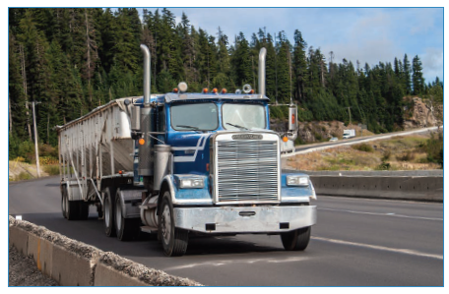
Intro to air brakes for combination units
In Part 1 of air brakes we learned about the air system for a single unit vehicle such as a truck or bus. In Part 2, we’ll be modifying that single vehicle so it will be able to pull air brake equipped trailers.

Slide 2
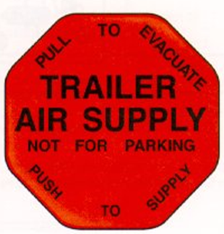
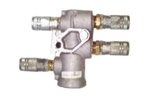
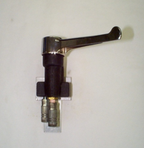
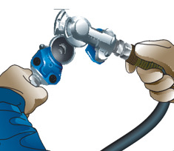
Air brakes valves for combination units
To convert a truck to a tractor (and be able to tow a trailer) we must add these key valves. Note that this is not a complete list of valves.
Trailer control valve - generally a red button inside the cab.
Tractor protection valve.
Also an optional valve commonly found in trucks - a hand valve to control the service brakes on the trailer independently from the foot valve.
Air lines and gladhands - to deliver the air to the trailers to be towed.
Notes:
Explain the reason we use gladhands to attach the air lines to the trailer.
Review different types of glad hands - rubbers in the gladhands can be replaced.
Tractor protection valve controls the air to the trailer. This allows us to drive the tractor without the trailer attached.
Trailer supply valve sends air to the tractor protection valve to allow air flow to the trailer.
Tractor protection valve, during a pre trip, must close or stop the air flow to the trailer between 45-20 psi. If the mechanical connection fails between the tractor and the trailer, it will automatically close, stopping the air flow to the trailer.
The hand valve controls the service brakes of the trailer only, independently of the foot valve and should not be used as a parking device.

Slide 3
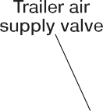
Air brakes components added
This diagram shows two service reservoirs, the dual foot valve, and the components that are added to a tractor with a dual air system to tow a trailer with air brakes.
Notes:
Components added
Trailer supply valve - opens the tractor protection valve
Tractor protection valve - supplies air to the trailer if the trailer supply valve is open and also prevents total air loss in the event of sudden air loss to the trailer or a separation of the trailer occurs.
Hand valve (not on all tractors) - controls service brake independently on the trailer only.
Pair of two-way check valves - supplies the trailer with blended air. By having this valve between the hand valve and the foot valve, the higher pressure will supply the control line.
In this diagram the driver is making a foot valve application.
The tractor front and rear brakes are being applied, and a control signal is being sent to the trailer through both of the two-way check valves - highest pressure will be delivered to the trailer.
The pressure in the supply line is the main reservoir pressure.
In most dual systems, the parking brake control valve (yellow button) is interlocked with the trailer supply valve (red button) so that applying the parking brake control valve causes all the parking brakes on both the tractor and trailer to apply. The parking control valve is also supplied with blended air.

Slide 4
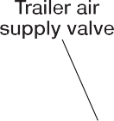
Failure in primary system
This diagram shows a tractor with a dual air system where there has been a failure in the primary air system on the tractor.
Notes:
This diagram shows a ruptured primary air tank.
Low-air warning would have activated.
When foot application is made, two-way valve takes air from highest pressure to apply brakes.
In this case of primary failure, results in tractor front brakes and trailer service brakes appling only.
Discuss the difference if failure is in the secondary tank.
In the event that the pressure in the tractor air system is lowered to between 20 and 45 psi (138 and 310 kPa) the trailer supply valve will close.
Because the trailer supply valve is supplied with “blended air” from a two-way check valve, the automatic shutoff will not occur until the service reservoir with the highest pressure is lowered to between 20 and 45 psi (138 and 310 kPa).
The automatic shutoff requirement should be checked as part of a pre-trip inspection. If it doesn’t function properly, the vehicle must be placed out of service until it is repaired.

Slide 5
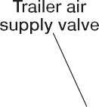
Air brake valves working together
This diagram shows how the tractor protection valve and the trailer air supply valve act together.
Notes:
This diagram shows a ruptured supply line.
Tractor protection valve protects the tractor air supply from depleting to an unsafe level in the event of separation.
The trailer supply valve should shut off automatically.
There is no pressure in the supply line to the trailer, the tractor protection valve has closed the passage to the trailer control line. No application air will be lost through that broken line.
If the control line separates, nothing will happen until the trailer brakes are applied resulting in air lost from the open line.
When a trailer is not connected, the trailer air supply valve will be in the closed position. This allows the tractor to be driven bobtail so that no air will be lost through the disconnected glad hand couplers.

Slide 6
Bobtailing
Driving a tractor without a trailer attached is called bobtailing.
Because a bobtail tractor has very little weight over the rear drive axles, it’s very easy to lock up the rear brakes, even with a light brake application.
To help prevent this unwanted lockup and to increase control, some tractors are equipped with a bobtail proportioning system.
Notes:
Instructor notes:
When the tractor is being driven with a trailer attached, the tractor brakes operate normally. But when bobtailing, the braking pressure to the drive axle brakes is reduced by as much as 75 %, preventing the rear brakes from locking.
The steering axle brakes receive full application pressure.
A tractor with a bobtail proportioning system will stop in a shorter distance and control will be increased, especially on wet or slippery road surfaces.
Because the steering axle brakes are doing most of the braking, a higher than normal pedal pressure is required.

Slide 7
Trailer system components
A trailer system has many of the components found on a truck system:
foundation brakes
air chambers
air reservoirs
control valves
The only major item not found on a trailer air system is an air compressor.
Air for the trailer must come from the tractor.
Notes:
The trailer system relies on the tractor for two important needs:
To receive compressed air from the tractor to fill the trailer reservoirs.
To receive commands about when to apply and release the brakes.

Slide 8
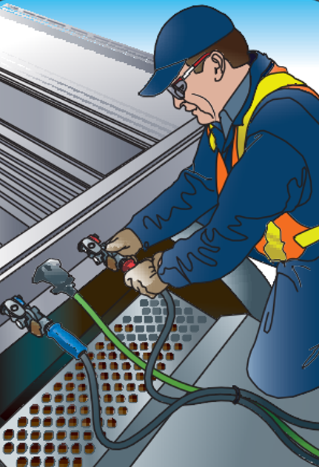
Air brakes trailer components cont.
There are two air line connections between the tractor and the trailer:
The air line that supplies the trailer reservoirs with air at full tractor reservoir pressure is called the supply line, or the emergency line.
The line that carries the control signal from the tractor is called the control line or commonly called the service line.

Slide 9
Air brakes trailer air system
There are two types of trailer air systems — those that use spring parking brakes and those that don’t.
Although most current trailers use spring parking brakes, some older trailers and converter dollies aren’t equipped with spring parking brakes.
Notes:
Instructor notes:
All trailer systems must have an emergency stopping system that will fully apply the trailer brakes if the trailer separates from the tractor.
You may hear the term “Dynamite” referring to fully applying the trailer brakes.

Slide 10
Trailer with spring parking brakes — charging
This diagram shows a typical trailer system that uses spring parking brakes for parking and for emergency (breakaway) stopping.
Notes:
The system shown uses one reservoir and two air valves, a relay valve for the service brakes, and a trailer spring brake valve that fills the reservoir and controls the spring parking brakes.
Most modern trailers have a full function valve in place of these two valves.

Slide 11
Air brakes trailer spring brake valves
The tractor is delivering air through the supply line to the trailer spring brake valve.
The spring parking brake valve directs air to fill the reservoir(s) and to release the spring parking brakes.
Notes:
Two types of systems:
One fills the reservoir(s) before releasing the spring parking brakes.
The other releases the spring parking brakes first, then fills the reservoir(s).
Once the trailer is coupled we will need to add to two steps to the pre-trip brake response checks.
Ask the students if they remember the two-way brake response from the single unit course.
With a trailer we will add two more checks - a tug test of the trailer spring brakes and checking that the service brakes work on the trailer.
The two-way response is now a four-way brake response.

Slide 12
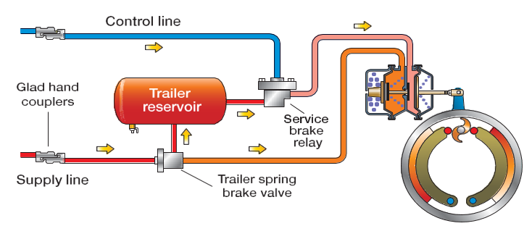
Trailer with spring parking brakes — service brake application
In this diagram, a control signal from the tractor has been sent through the control line to the trailer’s relay valve.
Notes:
Relay valve supplies air from reservoirs to service brakes.
Chamber pressure is the same as control signal pressure.
Explain to the students that the air delivered to the control line is the greater air pressure. Example: if a 10 psi application is delivered by the foot valve and a 15 psi is delivered by a hand valve application, the pressure delivered to the trailer will be 15 psi - the hand valve pressure.
If the control line becomes separated there will be no air loss until a foot valve or hand valve application is made.

Slide 13
Trailer with spring parking brakes — dynamited
This diagram shows a ruptured supply line
Notes:
Senses air loss in supply and applies spring brakes.
Air exhaust from trailer spring brake valve.
This is referred to dynamiting the trailer brakes.
Trailer brakes dynamite or apply when trailer lines are disconnected or trailer valve is closed.
Ask: If this happens what else should’ve activated? Answer - The tractor protection valve will activate this must happen by 45-20 psi but may happen at a higher pressure. This is to prevent total air loss to the tractor.

Slide 14
Braking combination units
When making a foot valve brake application, there will be an equal amount of air supplied to the service brakes on the tractor and the trailer.
If an application is made with the foot and a greater one with the hand valve, the service brakes on the trailer will be applied with more force.

Slide 15
Trailer ABS air brake systems
Trailer ABS systems use similar components as those on trucks and tractors The ECU may be powered from the stop lamp circuit, or may have a dedicated power source through the electrical connector.
Trailers with ABS air brakes will also have an indicator visible in the tractor’s mirror to indicate if the system’s not functioning properly. This warning light may be mounted on the front left side of the trailer or on the rear left side of the trailer.
On some air brake systems, there may be a trailer ABS warning indicator on the dashboard of the tractor.
Notes:
This ABS warning light is positioned on the side of the trailer at the rear. The driver should be able to see it in the side mirror.
A non-ABS tractor may tow an ABS equipped trailer however the ABS on the trailer will not function which may increase stopping distances.

Slide 16
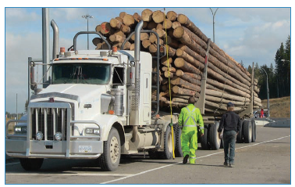
Combination unit air pre-trip
On the following slides, we’ll go over the steps to perform a pre-trip on a tractor-trailer unit.
You’ll notice that much of the information is the same as the single unit.

Slide 17
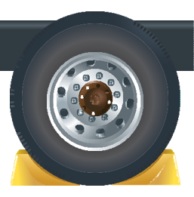
Getting started
Before getting started:
make sure you’re safe and seen
block the wheels and
place the transmission in low gear.

Slide 18
Reservoirs
Check to see if you have some air on the air gauges.
Drain the supply tank (wet tank) if equipped.
Recheck the gauges to see if the air in the reservoirs remained the same.
This confirms the one-way check valve is working.
Notes:
Ask the class if they remember the other type (ADIS ).

Slide 19
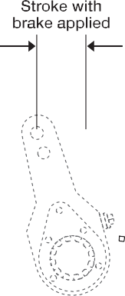
Under the hood – foundation brakes
Open the hood and check the travel of the slack adjustor.
Check the air line coming out to the brake chamber for cracks or damage.
Check the brake chamber to ensure it is in good condition and secure.
Repeat this on both sides.
Notes:
Ask students if they remember the travel allowed on a pry bar method (1/2 - ¾ inch).

Slide 20
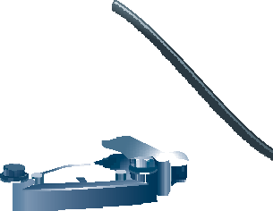
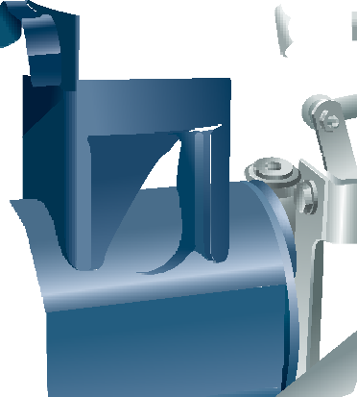
Under the hood - compressor
Check the compressor to ensure it is secure and the discharge line (the main line of the compressor) is in good condition.
Check that all other air lines under the hood are secure and in good condition.
Check that there are no coolant or oil leaks.

Slide 21
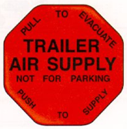
In cab
Get into the truck, confirm the vehicle is in neutral, and start the engine.
Release the brakes by pushing in the yellow and red button.

Slide 22
In cab – check governor operation
Press and release the brake pedal (called fanning down) to lower the air no lower then 80 psi. Allow the compressor to build to maximum air pressure between 105-135.
Next, lower the air 20 psi to confirm the governor puts the compressor into the reload stage. This will be determined when the needles begin to climb.
Continue to lower the air pressure further by fanning down to check the low air warning. It must come on by 60 psi.
Continue to lower the air pressure until the trailer supply valve closes. This must happen between 45-20 psi.
Exit the cab and confirm the trailer parking brake circuit has engaged.

Slide 23
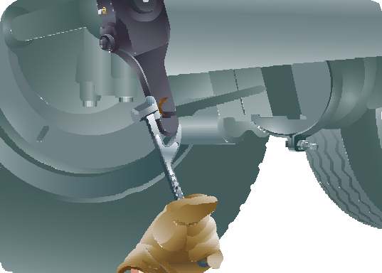
Check parking brake on trailer is engaged
Walk to the rear of the trailer to visually check that the push rods have extended, engaging the parking brake circuit.

Slide 24
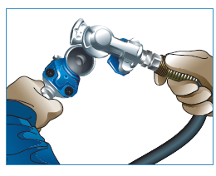
Disconnect air lines
Return to the front of the trailer and disconnect the air lines.
Notes:
Instructor notes:
Air lines don’t need to be stored at this time - they can just be laid on the frame or deck.
Ask: what’s going to happen when you disconnect the air lines?

Slide 25
Check tractor protection valve
Once the air lines are disconnected, make a brake application to confirm that the tractor protection valve is working.
This will be confirmed if there is no air escaping from the air lines while the brake pedal is being held.
Notes:
This application can be made by reaching into the cab and using your hand on the brake pedal.
This is a light brake application so as to not compound the brakes on the tractor.
Once this test is completed and the tractor has passed, reconnect the air lines.

Slide 26
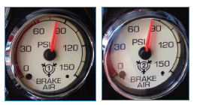
Continue compressor check
Re-enter the cab to complete the compressor check.
Start the engine and when the first needle hits 50 psi start timing. The compressor must build from 50 to 90 psi in under three minutes at an rpm of 1000-1200. Stop the timing when the last needle goes through 90 psi.
Release the parking brakes, push the trailer supply valve, and continue to build to maximum air to confirm that the governor puts the compressor into the unload stage between 105 and 135 psi.
Notes:
When building air from 50-90 psi the rpm may not exceed 1200 rpm. If it does, this part of the test must be redone by lowering both needles below 50 psi and starting again.
Once the last needle has gone through 90 psi, the student may use any rpm to build to maximum air.
As a learning moment you can have them continue to maintain the rpm at or below 1200 to encourage throttle control.

Slide 27
Start leak test
Notes:
Review continued steps on next slide.
Explain that in the image above the driver has made a brake application.

Slide 28
Leak test
With the brakes released, the engine off and the window open to hear any audible air leaks, make a firm brake application.
To perform a leak test, hold a firm brake application for one minute.
After the initial application, the system must not lose any more then four psi during that time with a single trailer and no more then six psi with two trailers.
Listen out the window for any audible air leaks.
Once completed, confirm there’s a minimum of 100 psi in the reservoirs and the brakes remained released.
Put the transmission in low gear and exit the vehicle.
Notes:
Review slide

Slide 29
Under tractor
Go under the rear of the vehicle to check that air tanks are secure and air lines are tied up and secure.
Then, move back to the rear wheels to perform the same checks as at the front.
Notes:
Instructor notes:

Slide 30
Check air lines and pushrods
Check at each wheel that the air lines going into the brake chambers are in good condition, the brake chambers are in good condition, and that you have the correct pushrod travel.
Use either the pry bar method or the applied stoke method.

Slide 31
Apply the parking brakes
Exit from under the vehicle and apply the brakes by pulling the yellow button.
Notes:
Explain that the Red trailer supply will usually pop at the same time.

Slide 32
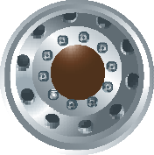
Remove wheel blocks
Once the brakes are applied remove the wheel blocks.

Slide 33
Four-way brake response test
Enter the vehicle and confirm the transmission is in neutral.
Start the engine, place in low gear with the parking brakes applied on the tractor and the trailer brakes released. Try to move the vehicle to confirm the parking brakes are holding the tractor.
Release the tractor parking brakes and apply the trailer parking brakes. Try to move the vehicle to confirm the parking brakes are holding on the trailer.
If yes, release the parking brakes on the tractor and trailer and allow the vehicle to roll ahead. Using the foot valve make a brake application to confirm the vehicle will stop.
If it stops, again allow the vehicle to roll ahead. Using the hand valve (if equipped) apply the service brakes on the trailer to confirm the vehicle stops.
Notes:
Confirm that the student understands that when they are doing this test that this is a gentle tug on the brakes and requires good control.

Slide 34
Adjusting a manual slack adjuster
Notes:
Use this slide to review adjusting a manual slack adjuster, if needed.
Use either pry bar or applied stroke method.
Note the direction the end of the S-cam rotated when the brakes where being applied.
If the brake need adjustment, push in the locking collar and turn the nut so the end of the S-cam rotates in the same direction it did to apply.
Tighten the nut until there is resistance.
Check to make sure there is no travel on the push rod
Back the nut off 1/3 of a turn and recheck the travel to confirm there is between ½ and ¾ inch of travel.
Confirm that the locking collar has come back out to cover the nut.

