Slide 1
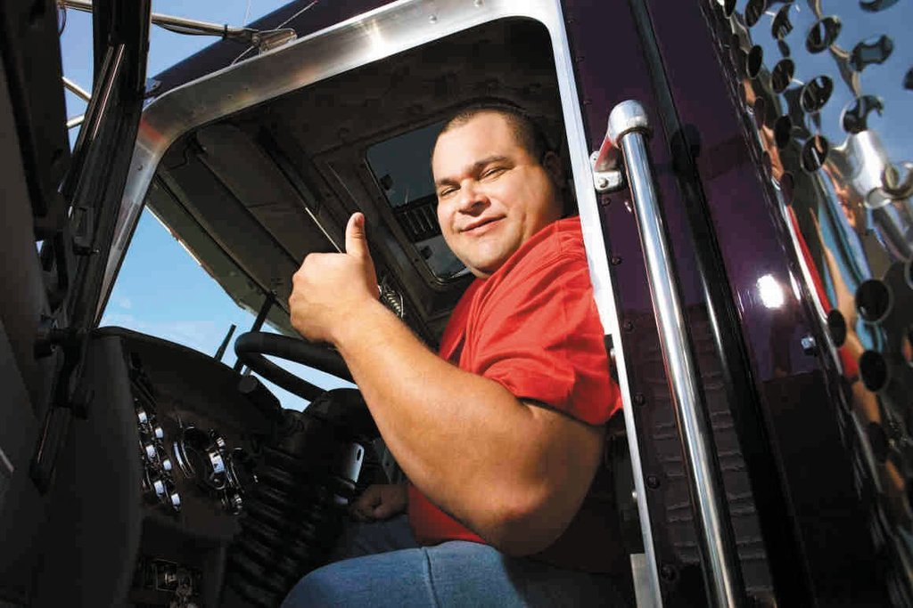
Welcome to MELT Class 1 Driver Training
Notes:
Welcome students and introduce yourself with brief background in trucking.

Slide 2
About the facilities
Emergency exits/ muster area
Washrooms
Coffee and lunch facilities
Cell phones
Health and safety protocols
Notes:
Instructor notes:
Review location of washrooms are as well as the emergency exits.
Advise if you have a lunchroom/coffee area location and breaks during the course.
Review use of cell phones during the course and any other rules or procedures students need to know.

Slide 3
Goal of Mandatory Entry-level Training (MELT)
“To help reduce the number of crashes and incidents by ensuring that all new Class 1 drivers have adequate control skills and knowledge and a responsible and professional approach to driving.”
Notes:
Instructor notes:
Briefly discuss the MELT program and why it has been implemented.

Slide 4
Unit overview
Importance of trucking industry
Types of Class 1 vehicles
Responsibilities of truck drivers
Class 1 driver’s licence process
What to expect during the course
Types of commercial driving jobs
Employment requirements
Notes:
Instructor notes:
Provide an overview of the unit

Slide 5
Getting to know you…
Why did you decide to take this course?
What job would you like to get?
What do you want to drive?
Do you have any commercial driving experience?
Notes:
Instructor notes:
This activity acts as an ice breaker for the trainees and provides a snap shot of trainees experience and expectations for the instructor.
Divide the class into partners. Have the partners interview each other using the questions above.
Discussion following the activity:
Ask the trainees to contribute what they may already know about trucking.
Do they know someone who is a commercial driver? If so, ask them to describe what the driver transports and what they know about the life of the driver.
What do they think it’s like to be a truck driver?

Slide 6
What it’s like to be a commercial driver?
Brainstorm: What do think it’s like to be a commercial driver?
Let’s watch this WorkBC Career Trek Video to get an idea.
https://www.youtube.com/watch?v=A81nvDdP5KY
Notes:
Brainstorm – What do think it’s like to be a commercial truck driver?
Acknowledge answers and probe as needed.
Show the video (5:17 min). If hyperlink doesn’t work, copy and past URL to your browser.
Discuss the video after watching it.
Brian heads to Terrace where he meets a truck driver. He rides along and learns about local and long distance trips and other opportunities, such as running your own business or becoming a heavy equipment operator. This job can be like a "paid tourist"

Slide 7
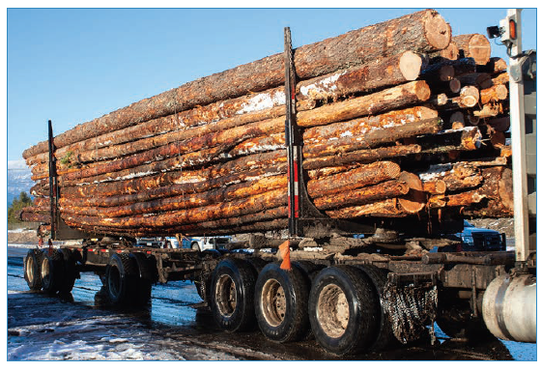
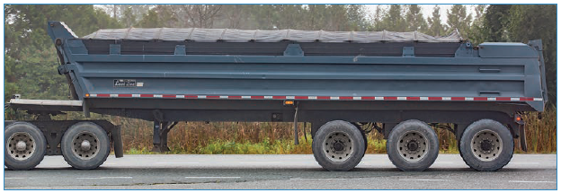
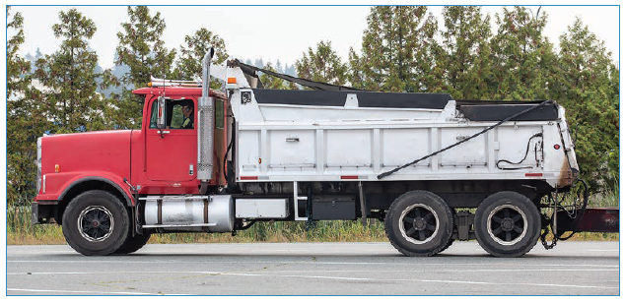
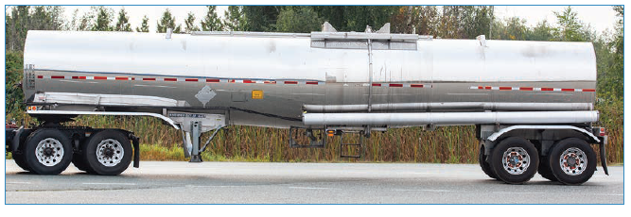
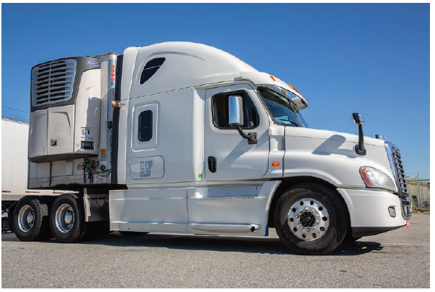
Equipment options
Notes:
These are only a few sample photos – provide other images for students to view.

Slide 8
Career options
What might be some different career options in trucking?
Notes:
Instructor notes:
Have trainees brainstorm ideas. Ideas may include:
Short-haul/regional delivery
Long-haul “over-the-road” driving
Local pick up and delivery
Owner-operator
Team driving

Slide 9
Short vs. long-haul
Short-haul advantages
Short-haul disadvantages
Long-haul advantages
Long haul disadvantages
Notes:
Instructor notes:
Brainstorm the advantages and disadvantages of long and short-haul driving.

Slide 10
Short vs. long-haul
Short-haul advantages
more time at home
familiar routes
more predictable
few log book worries
more time with family
Short-haul disadvantages
inconsistent or seasonal work
long work days
lower income
more traffic challenges
more backing up and maneuvering
Long-haul advantages
travel and scenery
independence
different challenges each day
Long haul disadvantages
being away from home
loneliness
time management
lifestyle, diet, fitness and health
unpredictable work
Notes:
Instructor notes:
Compare students ideas to the slide.

Slide 11
Driver licensing process
Complete the MELT program and pass:
Pre-trip inspection test
Road test
Driver's medical examination
Notes:
Briefly discuss each:
Class 1 licence with air brakes endorsement
pre-trip inspection test (includes air brakes)
road test
driver's medical exam - some medical conditions that may prohibit a driver from holding a Class 1 licence include: heart disease, brain tumors, hearing problems, musculoskeletal conditions, vision impairments, sleep disorders, kidney disease.

Slide 12
What you’ll learn to do
Vehicle inspections including the air brakes system
Backing
Coupling and uncoupling
Sliding the 5th wheel and tandem trailer axles
Driving in a variety of roadway, traffic, light and weather conditions
Mountain driving
Putting chains on a tire
Basic cargo securement
How to comply with hours of services regulations

Slide 13
OK, what do I have to do?
Written tests (pass is 80%)
Practical assessments:
Driving in town and on the highway in a variety of roadway and traffic settings
Backing activities
Vehicle inspection activities
Putting chains on a tire
Coupling and uncoupling a trailer
Each practical assessment is done twice
Homework completion
Attendance – complete all course hours
Notes:
Schools should provide this information in advance of the course. Ask if there are any questions.

Slide 14
Commercial driving is a big responsibility
Heavy commercial trucks like dump trucks and semis represent 3% of vehicles on the road.
They are involved in 19% of fatal crashes and incidents.
Notes:
Instructor notes:
This is one of the reasons driving a truck is such a big responsibility.

Slide 15
Top 10 incident types - WorkSafeBC
Top 10 incident types in general trucking by number of claims (2012-2016)
Rank | Accident Type | Claims
1 | Jack-knifed or overturned, no collision | 365
2 | Ran off highway, no collision | 95
3 | Vehicles moving in same direction | 76
4 | Moving & standing vehicle/equipment | 76
5 | Vehicle struck stationary object, roadslide | 72
6 | Head on collision | 54
7 | Highway accident | 31
8 | Intersection | 27
9 | Non-collision accident | 24
10 | Vehicle struck stationary object on the road | 23
 | All others | 150
Notes:
Instructor notes:
The table shows WorkSafeBC’s data from 2012 to 2016 listing the top 10 motor vehicle incident types for drivers employed in general trucking.
The incident type with the highest number of WorkSafe claims during this period was “jack-knifed or overturned” without involving a collision with another vehicle.
What do you think the key contributing factors to the number 1-ranked crash might have been?

Slide 16
Canada’s deadliest crashes involving commercial vehicles
Student guide – Chapter 1
Notes:
Instructor notes:
In Student Guide, briefly discuss a few of some of Canada’s deadliest crashes from the last few decades involving a commercial vehicle.
Don’t focus on Humbolt – it will be discussed later.

Slide 17
Costs
Personal
Health
Financial
Social
Notes:
Brainstorm – have students brainstorm all the costs and consequences of truck crashes and incidents.
The costs take a tremendous toll on drivers and companies.
visible (direct) costs
hidden (indirect) costs
human, psychological, and environmental costs

Slide 18
Employer expectations and requirements
A completed employment application form
Personal driver’s abstract and National Safety Code abstract (dated within 30 days)
Medical information
A criminal record check (dated within a specified period)
Records of your previous work experience and training that are relevant to your job
Consent to participate in periodic drug screening

Slide 19
Additional training
Employers are required to provide additional training:
operation of specialized equipment or vehicle features,
workplace orientation,
loading and transportation of specific cargo,
occupational health and safety rules,
company policies (dress codes, code of conduct, disciplinary policies, substance abuse policies etc.), and
duties and scope of your position, condition of employment, and so on.

Slide 20
What are employers looking for?
Communication skills
Integrity and honesty
Commitment to learning
Competence in performing work
Loyalty to the company/employer
Responsibility and accountability
A willingness to follow rules and policies
A commitment to maintaining confidentiality
Good work habits – punctuality, meeting obligations
Respectfulness, courtesy to fellow employees and customers
Notes:
Instructor notes:
Review the slide, briefly discussing each point.
More on communication later.

Slide 21
Key responsibilites
Maintain a good driving record
Know and abide by the provincial and federal laws
Develop advanced driving skills
Positive attitude, respect and patience
Avoid impairment and distraction
Notes:
Instructor notes:
Your success as a professional truck driver goes beyond your driving skills - your interpersonal skills are also important.
Employers often expect that you have basic knowledge and understanding of the laws and other compliance requirements.
To be successful as a professional driver, you must ensure that you have a clean driving record.
Carriers are required by law to keep specific records on each employed driver’s file for four calendar years after the driver files have been created, established or received.
According to The Commercial Carrier Record-keeping and Commercial Vehicle Driver Reporting Regulations, records must also be kept for each person who is authorized to drive an NSC vehicle for a carrier. See lesson plan for list.

Slide 22
Do you have what it takes??
Take the driver aptitude survey
Notes:
Instructor notes:
Refer students to the truck driver aptitude survey and have them complete it or assign as homework.
Explain that the results are private, for their information only, and they are not required to share.

