Slide 1
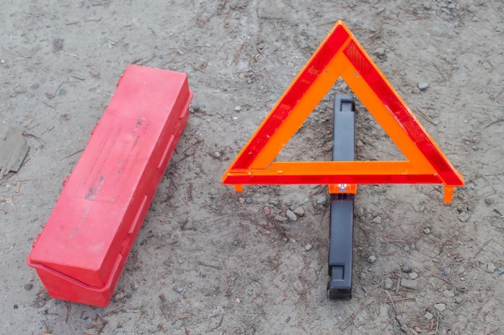
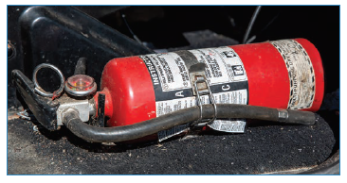
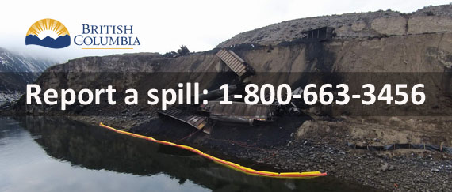
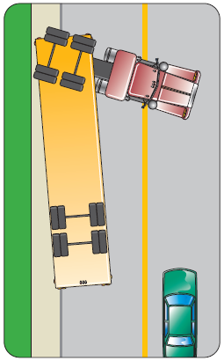
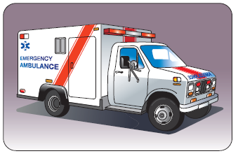
MELT Class 1 Driver Training Handling emergencies
Notes:
Instructor notes:

Slide 2
Lesson overview
Handle emergency incidents in a professional manner.
Emergency equipment and its use.
Keeping yourself save.
Importance of workplace practices, policies and procedures.
What to do in specific emergency situations.
What to do if you’re in a crash.
Incident reporting.
Notes:
Instructor notes:

Slide 3
General emergency steps
Turn on your 4-way flashers.
Ensure no danger to self.
Wear personal protective equipment as needed.
Deploy warning devices.
Locate emergency contact information.
Question - Why is it important to follow your workplace practices, policies and procedures?
Know what needs to be reported to your employer, police and other agencies.
Notes:
Instructor notes:
Quickly and calmly take the necessary actions to safeguard the vehicle and other motorists.
If the vehicle can be moved, move it as far off the roadway as safely possible — this should not affect the police officer’s investigation. This is especially important on busy or high-speed roads where it may be dangerous to leave vehicles in the driving lanes.
It’s important to follow workplace practices, procedures and policies when engaging emergency support such as towing, recovery and repair services, and when speaking with police, media, or the public.
When you get hired, ask your employer for their procedures and policies if they don’t train you in them.
Following required procedures will help keep you safe and help protect you from liability in the event something goes wrong.

Slide 4
Emergency supplies – activity
Imagine you are in a crash or stranded for a day or two when the road gets closed due to avalanche…
What supplies might you need?
Discuss in your groups and be prepared to share your ideas.
Notes:
Instructor notes:
In groups of 3-5, have students brainstorm what emergency supplies they think they should have with them on the job.
After 5-10 minutes, bring the groups together and circle around to each group for one idea at a time until all ideas have been shared and discussed as needed.
See the lesson plan for supply ideas.

Slide 5
Warning devices
During daylight hours, the minimum for approved warning devices is:
two red flags that measure at least 30 cm by 30 cm, or
two warning devices that have been approved for daylight use — including flares, fuses and reflectors.
At night use flares, fuses, reflectors and red lanterns.
Notes:
Instructor notes:
It is recommended to use warning devices for all emergencies, whether they occur during the day or night, or on-road or off the road.

Slide 6
Warning device deployment
Notes:
Instructor notes:

Slide 7
Emergency situations
In the next section, we’re going to discuss:
Getting stuck
Mechanical failure
Needing a tow
Tire failure
Personal medical distress
Notes:
Instructor notes:
Review the steps to free a stuck vehicle.
Avoid spinning the drive wheels and rocking, this will dig the vehicle in deeper. On ice or snow, spinning wheels will warm the ice or snow under the tires, reducing traction even more.
Dig out from in front of the wheels. Scatter sand or gravel in the wheel path. Lay loose chains in front of the vehicle’s tires.
When ready to try pulling out, start with the steering wheel facing straight ahead. Don’t turn the wheel until the vehicle is moving.
Start in second or third gear, using very little power. This keeps the wheels from spinning and gives a smoother application of force.
Accelerate smoothly and gently. Ease off at the first sign of spinning or slipping. Allowing the wheels to continue spinning can cause you to dig in deeper and/or cause a spinout.

Slide 8
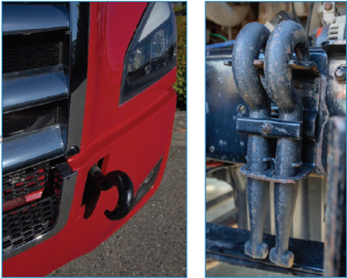
Towing
Notes:
Instructor notes:

Slide 9
Anti-lock braking systems (ABS)
Mandatory in Canada on all trucks and buses over 4,560 kg manufactured since April 1, 2000 and on all commercial trailers equipped with air brakes.
Adjusts air or hydraulic pressure in the brake chambers to prevent wheel lockup.
Allows the driver to steer while applying continuous hard brake application.
Doesn't allow you to drive faster or stop sooner.
On some surfaces such as gravel, braking distance with ABS may be longer.
May help prevent jackknifing.
Notes:
Instructor notes:

Slide 10
Threshold braking
Requires a sensitive touch on the brake pedal.
Do not “pump the brakes” – this will only extend the stopping distance and reduce air pressure.
Apply brake pressure up to the point of almost locking the wheels, then backing off just enough to prevent the skid.
Constantly adjust pressure on the brake pedal throughout the stop to keep it at that point.
If the brakes lock, immediately ease up and reapply.
Once mastered, will stop you faster than any other technique.
Notes:
Instructor notes:

Slide 11
Skid avoidance and control
What can cause loss of traction?
How can you anticipate and react to a skid?
Notes:
Instructor notes:
Discuss these questions allowing students to share their experiences.

Slide 12
Jackknife
Notes:
Instructor notes:

Slide 13
Trailer swing
Notes:
Instructor notes:
To avoid a jackknife:
Know the weight, height and loading position of your cargo
Remember that a light or empty vehicle will slide more easily
Increase following distance
Extend your braking distance
Avoid braking in curves
Avoid swerving and braking at the same time
Use the engine brakes on lower settings when roads are slippery and test the traction carefully
Install traction devices if road conditions are questionable

Slide 14
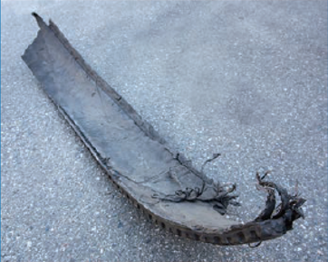
Tire failure
Blowouts can cause tremendous steering and wheel vibration, but don't be alarmed.
Don’t immediately apply the brakes.
Take your foot off the gas pedal to slow down and steer the vehicle firmly in the direction you want to go.
Bring the vehicle to a stop off the road.
Turn on 4-ways.
Notes:
Instructor notes:

Slide 15
Flooded roadway
If you’re going to drive through:
slow to a crawl as you approach the water,
place a slight drag (a light constant pressure) on the brakes while you drive through,
the drag will reduce the amount of water on the brakes, and
after driving through the water, apply the brakes for a short distance to dry them out.
Notes:
Instructor notes:

Slide 16
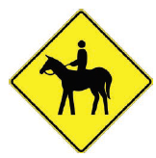
Emergency actions
Wildlife- moose, deer, elk, caribou, bighorn sheep, cattle and horses.
Notes:
Instructor notes:

Slide 17
Emergency actions – activity
Oncoming vehicle in your lane.
In groups, discuss possible scenarios and options.
Notes:
Instructor notes:
Allow groups about five minutes to discuss then have them report their ideas in the large group and discuss.

Slide 18
Emergency actions to avoid a crash
Reduce speed – brake hard.
Select alternative path.
Perform emergency steering.
Glancing blow better than head on.
Watch your clearance.
Try to avoid going right off the road.
Look where you want to go.
Notes:
Instructor notes:

Slide 19
Emergency actions
Gravel shoulder recovery
Reduce speed gently.
Keeping one set of tires on the pavement.
Turn back gentle when road is clear of traffic.
Don’t brake while turning.
Don’t oversteer!
Notes:
Instructor notes:
If the wheels of your tractor and/or trailer leave the roadway and begin to run on the shoulder, do not be in a hurry to get them back on the road. Swerving quickly back onto the road may cause you to oversteer and skid across to the other side – it could even cause a rollover.
Don't panic. Grip the steering wheel firmly. Take your foot off the gas pedal to slow down. Avoid heavy braking. When the vehicle is under control, steer toward the pavement. Be prepared to correct your steering and increase speed when your wheels are fully back on the pavement.

Slide 20
Loss of brakes
News story – Anarchist Mountain fire
Read the story in your groups and discuss these questions:
What could’ve caused the brakes to overheat?
What could’ve caused the rig to overturn?
What were the consequences?
How could this crash have been prevented?
Notes:
Instructor notes:

Slide 21
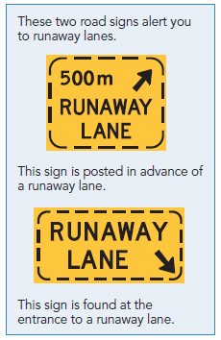
Loss of brakes continued
Often caused by too much heat – overdriving the ability of the brakes.
This is driver error.
Use a gear that will hold the vehicle back without using the service brakes.
Engine brake failure – stop! Use low gear until safe place to pull over – do not continue down the hill until engine brake is repaired.
Notes:
Instructor notes:

Slide 22
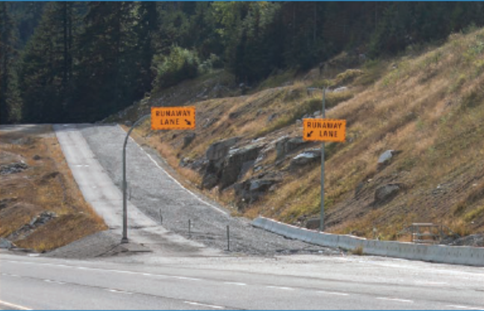
Runaway lanes
If it feels like you have no brakes… don’t chance it – take action.
Notes:
Instructor notes:
Typically a long sand or gravel filled lane connected to a steep downhill grade section of a main road and is designed to accommodate large vehicles.
The ramp allows a moving vehicle's kinetic energy to be dissipated gradually in a controlled and relatively harmless way, helping the operator to stop it safely without a violent crash.
Runaway lanes are a final safety measure for when you lose your brakes. Use a runaway lane if applying the brakes has little or no effect on slowing the speed of your vehicle.

Slide 23
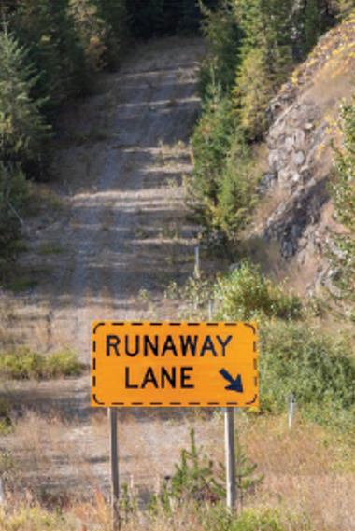
Gravity bed runaway lane
This is the type of runaway lane that leads a truck up a slope.
It uses a combination of gravity and a bed of gravel to slow the truck down and keep it from sliding backwards.
You’ll notice these runaway lanes on the Coquihalla Hwy.
Notes:
Instructor notes:

Slide 24
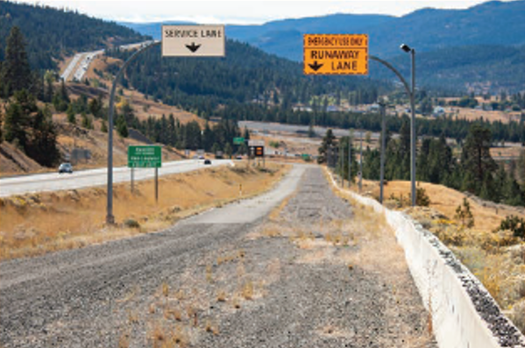
Arrester bed with gravel bed
Remember where runaway lanes are on your regular routes.
Never park in or in front of a runaway lane.
Notes:
Instructor notes:

Slide 25
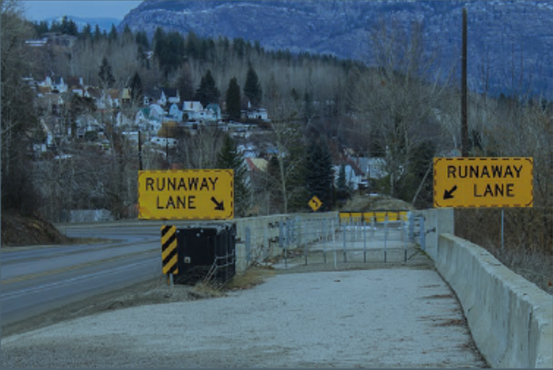
Arrester bed with cable nets
Notes:
Instructor notes:
This type of runaway lane relies on a cable netting system and/or a gravel bed to slow down the truck on either a horizontal or descending grade. You’ll notice one of these runaway lanes at the Horseshoe Bay Ferry Terminal.

Slide 26
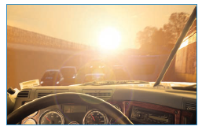
Loss of visibility – what to do
Headlights fail
Mud, slush, snow on windshield
Fog or whiteout
Glare
Notes:
Instructor notes:

Slide 27
Fire – common causes
Running with a soft tire.
Overheated brakes, either from misuse or maladjustment.
Leaking fuel system, pump, filter, tanks or lines.
Unequal distribution of load, causing trailer to lean and rub on tires.
Careless smoking.
Carelessly placed flares, lamps or fuses used in an emergency.
Short circuits in the electrical system.
Spontaneous combustion may occur in a van or trailer - know the nature of your cargo.
Stopping on dry grass during drought – heat from the truck ignites the grass.
Failures or overheating of the after treatment system.
Notes:
Instructor notes:
A fire can start from several causes. The following are tips to prevent fires.
Never start a vehicle with a fuel leak.
Repair the leak and use an approved absorbent material to soak up the fuel spill.
Shut off the engine when refueling.
Touch the fuel hose nozzle against the filler pipe of the vehicle tank before filling to ground it. This prevents sparks caused by static electricity.
Do not smoke near the fueling areas.
Check your tire pressure often. Soft tires build heat and can cause a fire.
Ensure that all your vehicle’s brakes are fully released when the vehicle is moving. Dragging brakes generate heat that can ignite grease in the hubs when the vehicle stops.
When a fire occurs:
Stop in a safe position away from buildings and other vehicles.
If it is a combination unit, uncouple the unit when possible.
Contact the fire depart­ment and tell them what type of material is burning.
Based on the type of fire, take all possible steps to extinguish it.
If the fire might be due to a short-circuit, remove battery cables if possible.
If the cargo is of an explosive nature, stop traffic and warn people to stay back.

Slide 28
Fire – what to do
Stop in a safe position away from buildings and other vehicles.
Call 911 and give your location and any critical information regarding your cargo.
Ensure your safety and the safety of others nearby.
If it is a combination unit, uncouple the unit if possible.
Take all possible steps to extinguish it.
If the fire might be due to a short-circuit, turn off the battery switch if equipped or remove battery cables if possible.
If the cargo is of an explosive nature, stop traffic and warn people to stay back.
If carrying live animals, release them if possible.
Call your supervisor.
Notes:
Instructor notes:

Slide 29
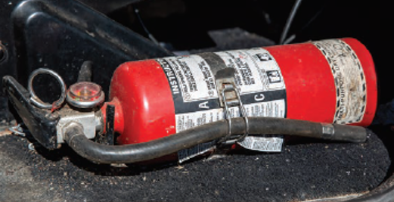
Fire extinguishers
Remember the word PASS:
P – Pull the pin
A – Aim low
S – Squeeze lever
S – Sweep from side to side

Slide 30
Forest fires
Within B.C., report forest fire sightings to:
1-800-663-5555
Cell: *5555

Slide 31
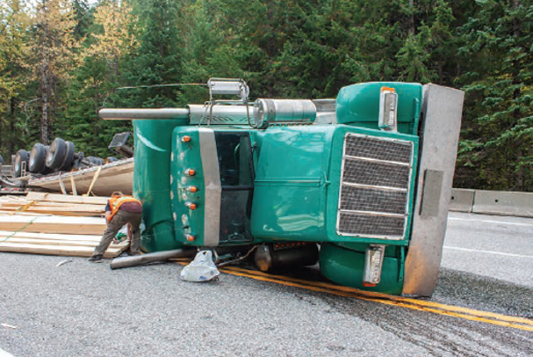
Crashes and incidents
Procedures and responsibilities
Notes:
Instructor notes:
Explain that in Canada, when you’ve been involved in a crash, or do something that causes a crash, you must stay at the scene and provide assistance and information.
Even if you were not involved, you should still stop and offer to help if the police or other emergency services has not yet arrived. You’d want others to do the same for you.

Slide 32
Crash procedures - activity
Imagine you’re in a crash or arrive at the scene of a crash.
What should you do for a minor vs a major crash?
Minor crash – minor vehicle damage or injuries only
Major crash - serious damage, injuries or death to others
What reporting would you need to do?
You have 15 minutes to discuss.
Notes:
Instructor notes:
After the discussion, refer to the handling emergencies section in the student guide to cover anything missed.

Slide 33
Loss of load and spills
Any spill that threatens the environmental quality of water, land or air must be reported.
Possible threats include gas leaks, oil, diesel or chemical spills and any other release of hazardous material to the environment.
Notes:
Instructor notes:
Have students add the spill phone number to their contacts on their phone.

Slide 34
Legal reporting requirements
Exchange of information.
When to report to police.
Reporting to ICBC.
Notes:
Instructor notes:
Exchange information:
Your name and address
The name and address of the registered owner of the vehicle
The licence plate number
Insurance information
Report collisions to police if:
Anyone has been injured or killed
An impaired driver is suspected
A hit and run has occurred
It involves an out-of-province vehicle
Vehicles need to be towed
Report a claim to ICBC online or by phone, 24 hours a day, seven days a week. Please provide the following when reporting a claim:
The licence plate number of each vehicle involved
Driver’s licence number of each driver
Insurance information for vehicles not insured by ICBC
Police file number (if applicable and available)

Slide 35
Near misses
A near miss is an event that did not result in injury, illness, or damage – but had the potential to do so
Follow company procedures.
Can occur when driving or at other times such as loading/unloading, during vehicle inspections or other workplace activities.
Notes:
Instructor notes:
History has shown repeatedly that most serious and catastrophic events, were preceded by warnings or near miss incidents.
Recognizing and reporting near miss incidents can significantly improve worker safety and enhance an organization’s safety culture.

