Slide 1
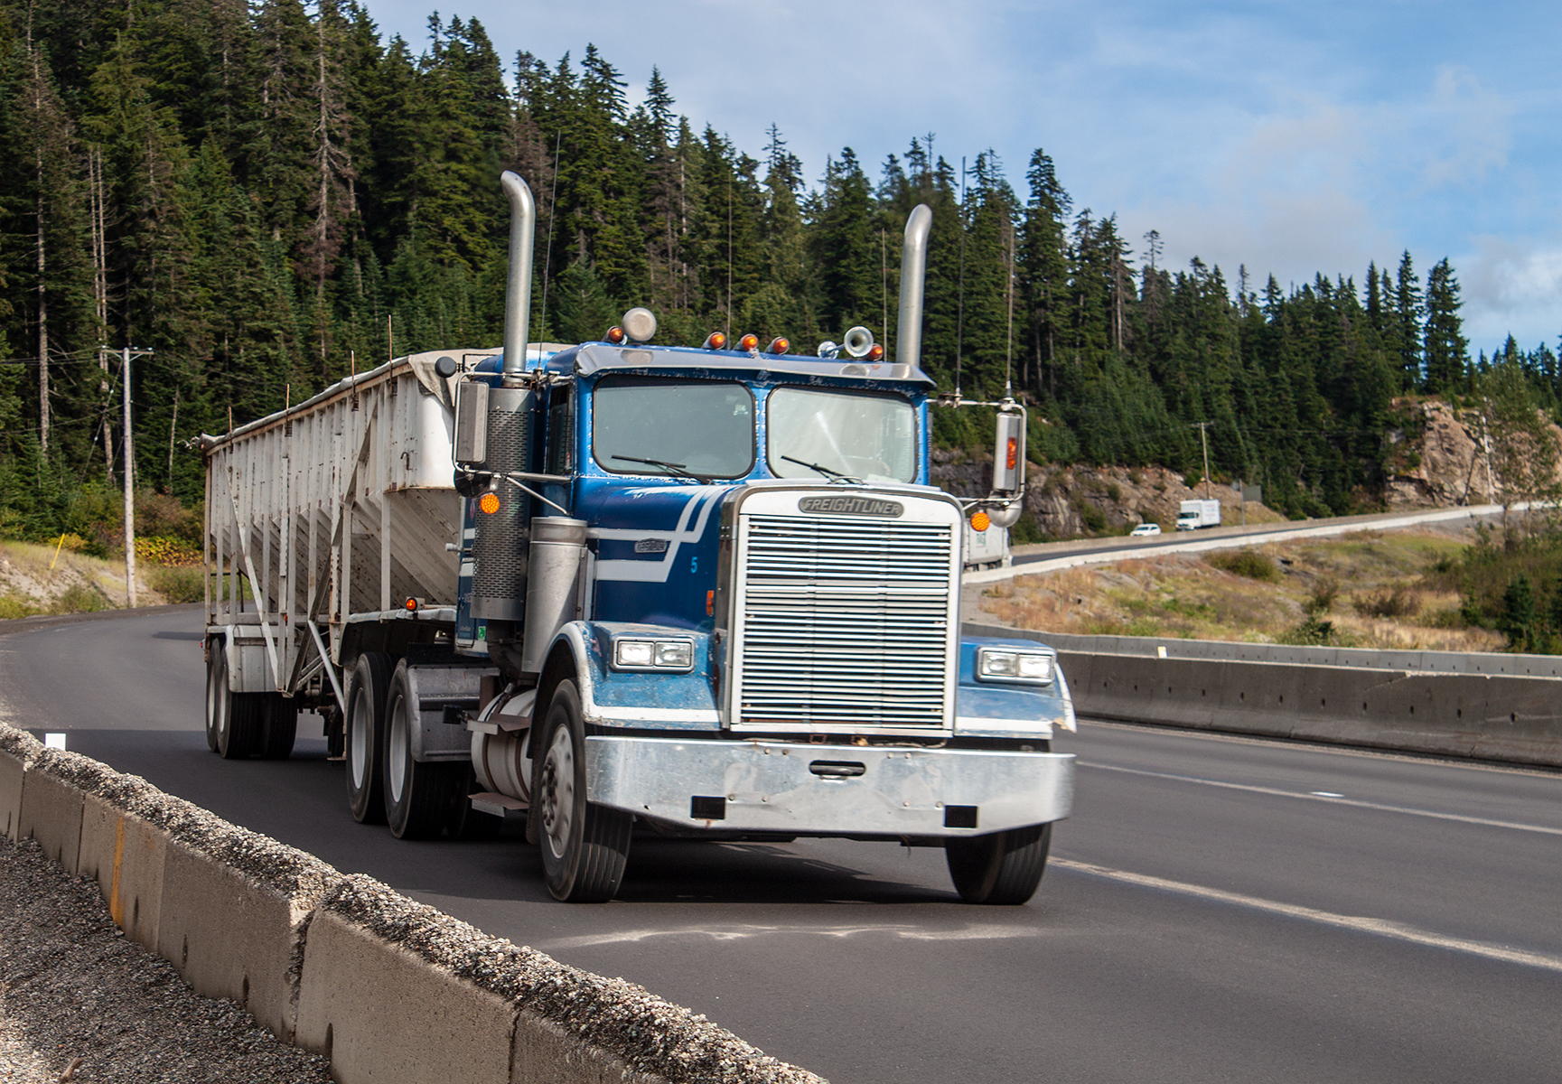
Vehicle Components and Systems

Slide 2
Lesson overview
Lubrication system
Coolant system
Electrical system
Brake systems
Tires and wheels
Trailer coupling systems
Vehicle body and frame
Suspension systems
Driveline systems
Steering system
Fuel system
Air intake and exhaust
Notes:
The purpose of this unit is to familiarize students with the systems of a tractor trailer and how they function and work together.

Slide 3
Vehicle body and frame
Vehicle body and frame includes the occupant section of the vehicle and the metal infrastructure supports the rest of the vehicle.

Slide 4
Vehicle body and frame
Hood or engine enclosure This is the part of the truck body within which the engine is housed. Cab - vehicle body This is the part of the truck that accommodates the driver and the occupants of the vehicle. A vehicle frame, also known as its chassis, is the main supporting structure of a motor vehicle.

Slide 5
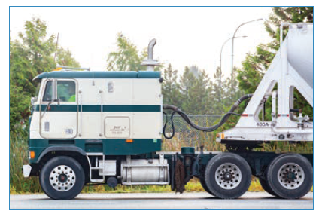
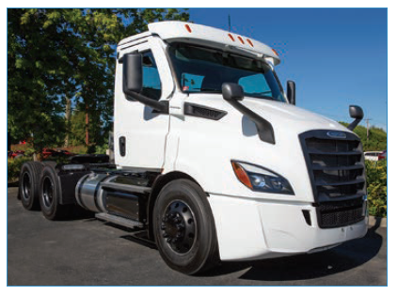
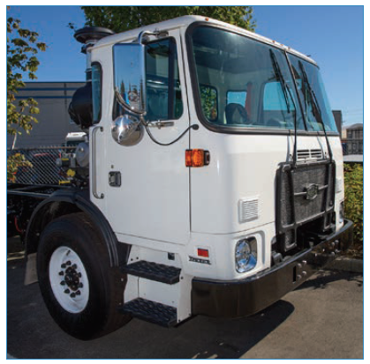
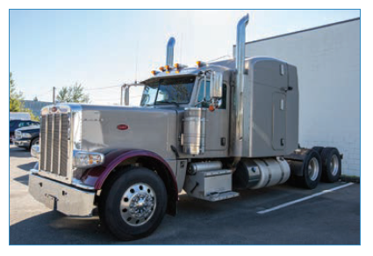
Cab design

Slide 6
Cab
Seat
This is in the interior of the truck for the driver and any co-occupant’s comfort.
Seat belt/occupant restraint
Seat belts save lives, reduce injuries and provide the greatest protection when worn properly in the event of a collision.

Slide 7
Vehicle body and components
Mud flap
Protects the vehicle and other road users from rocks, spray and debris. Mud flaps are flexible.

Slide 8
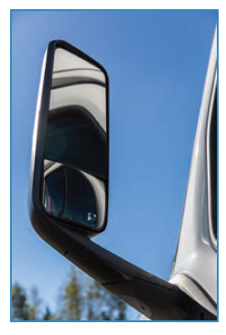
Vehicle body and frame
Mirrors Flat and convex mirrors must be correctly adjusted to ensure the widest possible field of vision. Doors To enter and exit the cab.
Notes:
Mirrors: Drivers of large commercial vehicles rely on their mirrors to observe traffic conditions behind and beside the vehicle. Making effective use of mirrors when performing reversing manoeuvres and driving on a highway or city streets is imperative to ensure the safe operation of a tractor-trailer. Flat mirrors give you a clear view along the side of your truck and the convex mirrors should be aimed to fill in the blind spots around the truck.

Slide 9
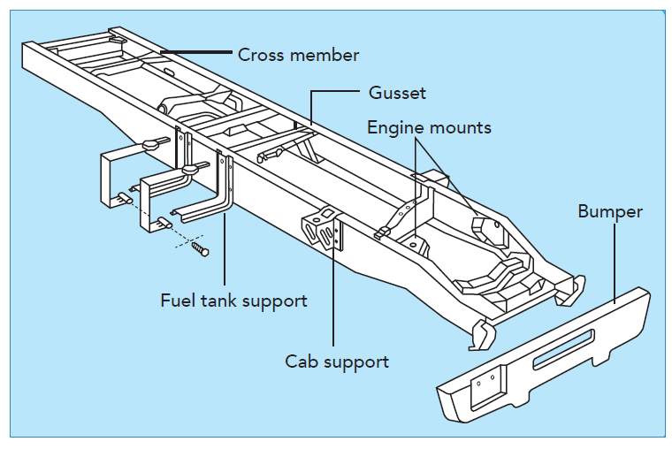
Frame assemblies

Slide 10
Suspension system and axles
The next section includes:
Axles
Air ride suspension
Leaf spring suspension
Shock absorbers

Slide 11
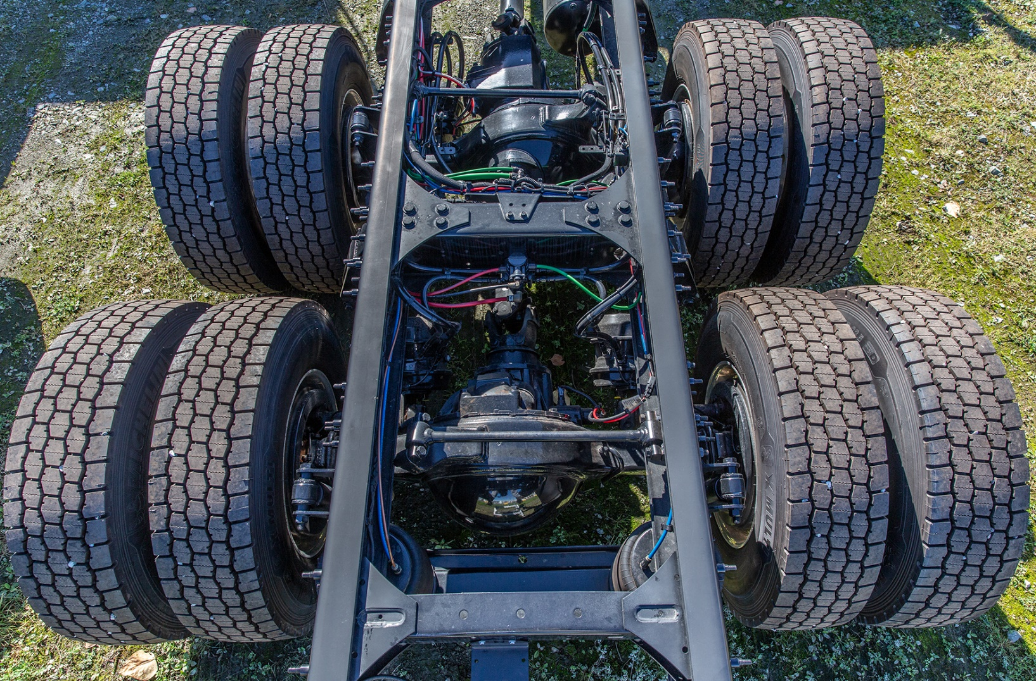
Suspension systems
Suspension & frame attachments The body of the tractor-trailer is connected to and strengthened by the frame. The frame rests on the suspension system. The suspension supports carries and distributes the weight of vehicle
Notes:
The suspension system also supports the axles by enabling axle movement when surface or ground changes. The system is divided into spring leaf suspension and air bag suspension.

Slide 12
Suspension system and axles
Front tractor axle The steering axle on a truck. Rear tractor axle Power is transferred from the engine and the powertrain to the wheels by the rear drive axle.
Notes:
The axle is a shaft on which two or more wheels revolve. It connects the wheel to the rest of the vehicle and also supports the weight of the vehicle. Tractors have a front axle and one or more rear drive axles
Front tractor axle: A steering axle is one of the components of a vehicle that contributes to its ability to be directed toward a desired route.
Rear tractor axle: This is also called drive axle.

Slide 13
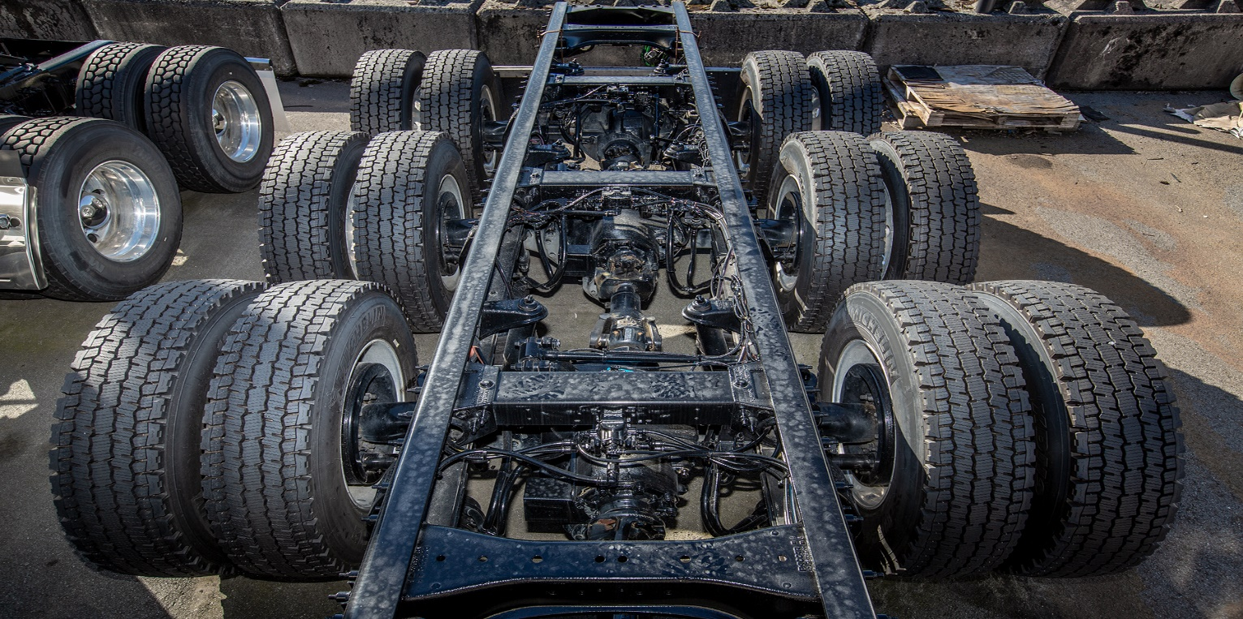
Suspension system and axles
Single drive axle Tandem drive axles Tri-drive axles
Notes:
Single axle: Some two-axle trucks have one rear axle. This rear axle is called the single drive axle.
Tandem: Some trucks have two consecutive rear axles (two drive axles). This type of axle is called tandem axle.
The additional axle enables the truck to accommodate and carry heavier load. Some tandems have a drive and a non-drive axle. The non-drive axle mounted behind the drive axle is called the tag axle while the one mounted ahead of the drive axle is called the pusher axle. Tandem axle tractor with two drive axles is described as twin screws. Tractors equipped with two drive axles have more traction on slippery surfaces (mud or snow).
Tri-drive axles: This is an axle group, on a tractor, consisting of any 3 consecutive axles of a vehicle where the axles are evenly spaced.

Slide 14
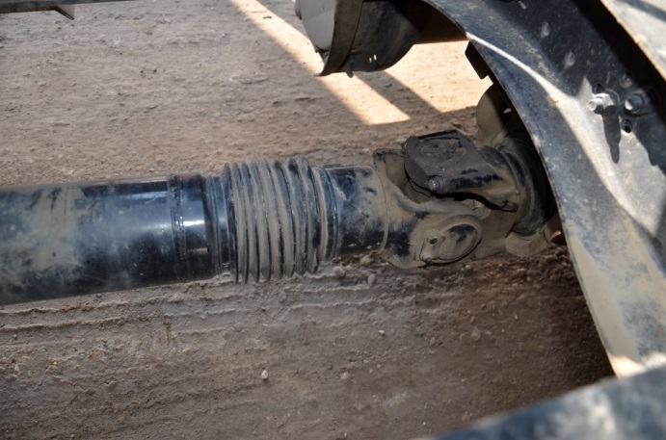
Drive line system
Drive shaft This is a shaft that runs from the transmission to the first drive axle and between the front and the rear axles.
Notes:
Drive shaft:

Slide 15
Differential
When a tractor-trailer rig goes around a corner, the outside wheel rotates faster than the inside wheel.
The differential allows the vehicle to have different speeds for each wheel attached to the rear axle.

Slide 16
Interaxle lock
Interaxle differential lock control This control splits the power between the rear axles Unlocked, the axles turn independently of one another on a dry surface. In the locked position, power to the axles is equalized to help provide traction in slippery conditions or on uneven ground.

Slide 17
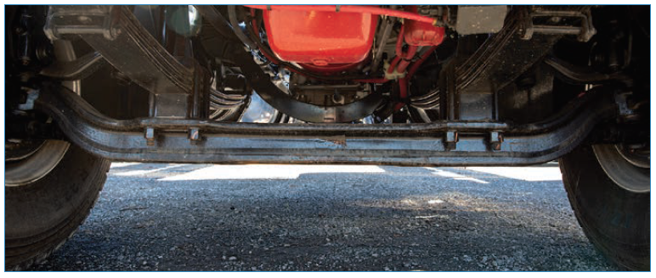
Suspension system and axles
Steering axles

Slide 18
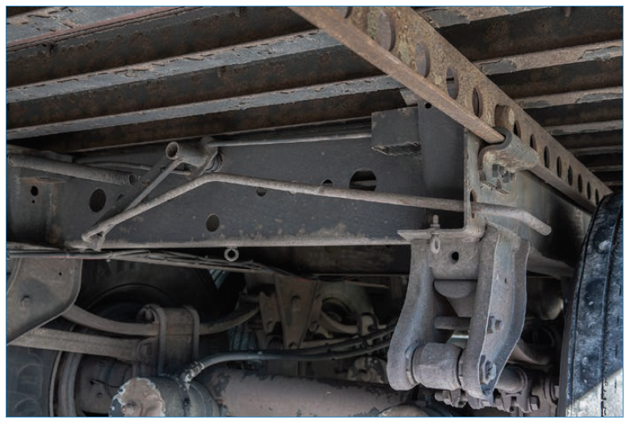
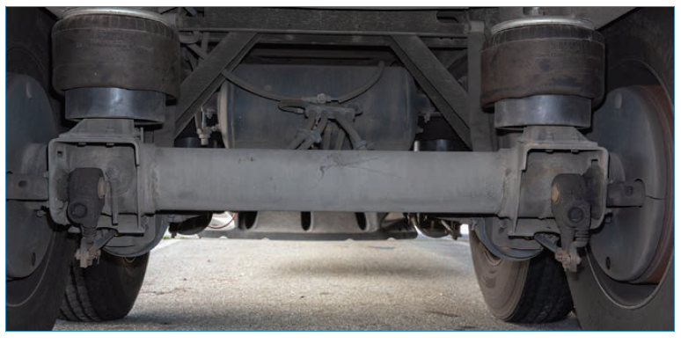
Suspension system and axles
Sliding axles Dead axles

Slide 19
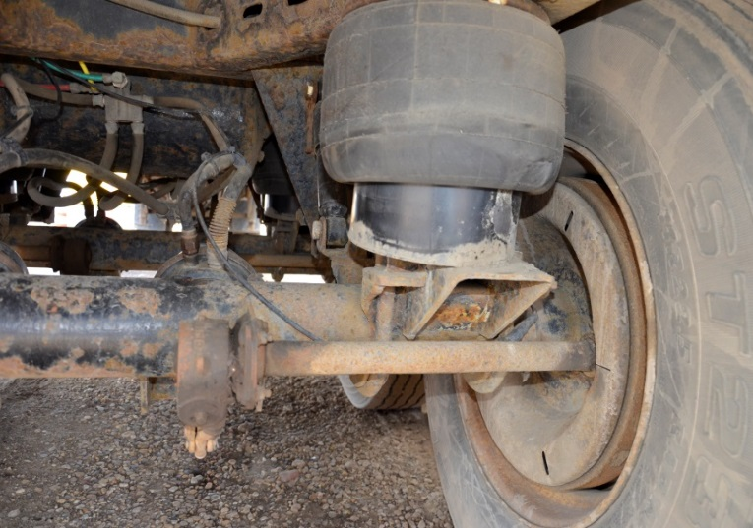
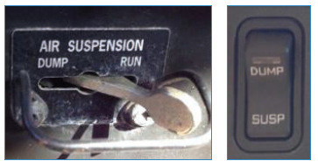
Suspension system
Air ride suspension This type of suspension is filled by the vehicles air system.

Slide 20
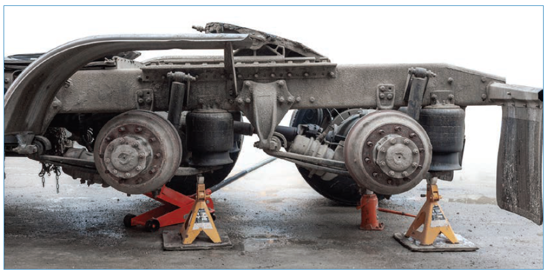
Air ride suspension

Slide 21
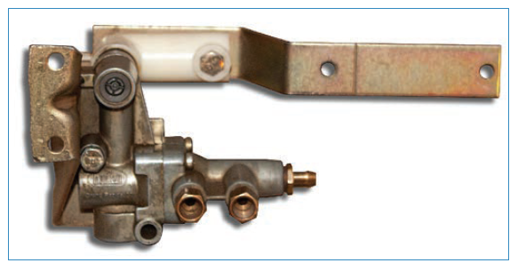
Suspension system
Leveling valve

Slide 22
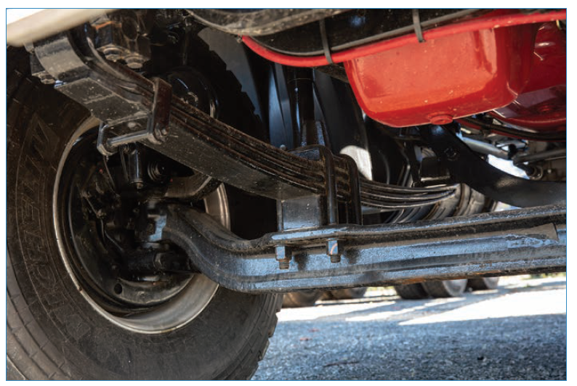
Suspension system
Leaf spring suspension

Slide 23
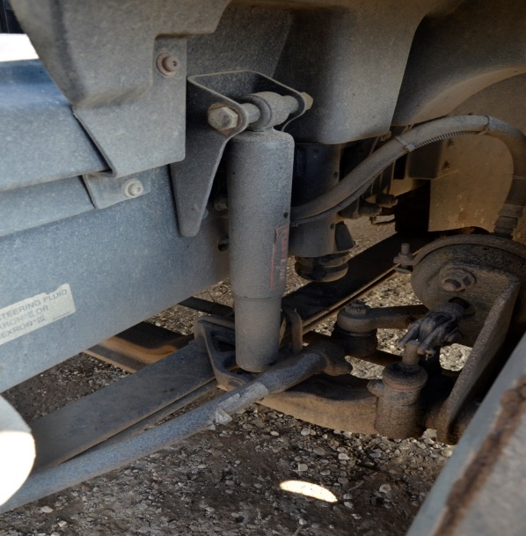
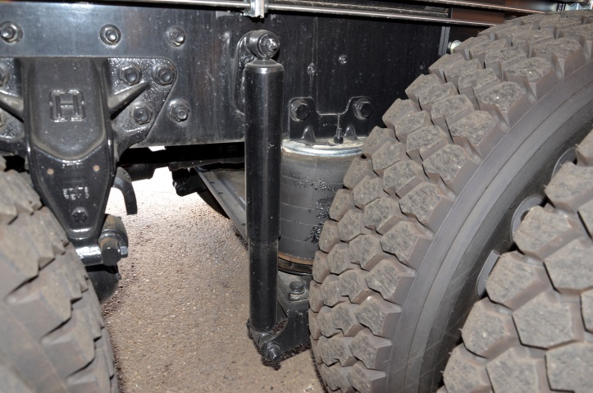
Suspension system and axles
Shock absorber This is assists in reducing the motion of the vehicle when the wheel moves over an uneven surface.
Notes:
Shock Absorber: A shock absorber or damper is a mechanical or hydraulic device designed to absorb and damp shock impulses. It does this by converting the kinetic energy of the shock into another form of energy (typically heat) which is then dissipated. Most shock absorbers are a form of dashpot (a damper which resists motion via viscous friction).

Slide 24
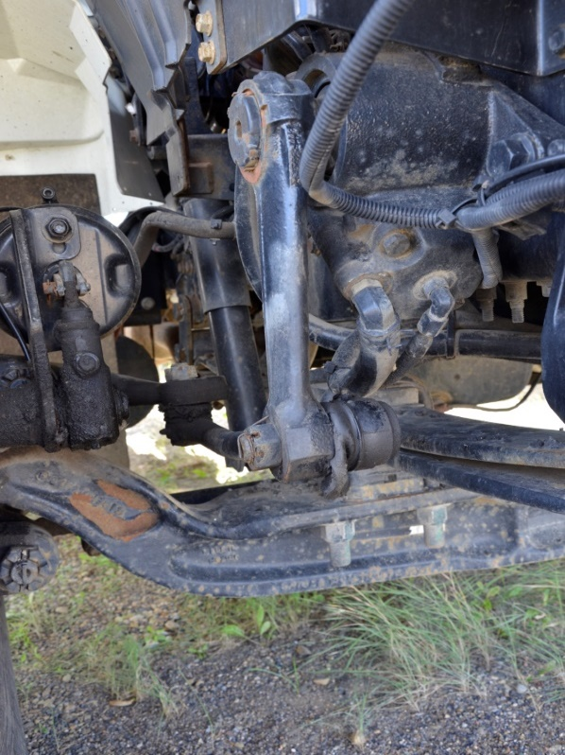
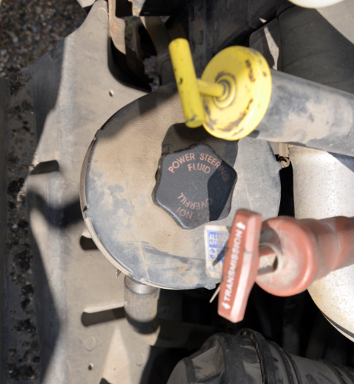
Steering systems
Power steering system Comprised of hoses, pump and power steering fluid. Assists the driver to turn the wheel with less effort.
Notes:
Power steering system: In motor vehicles, a power steering system helps drivers steer the vehicle by augmenting steering effort needed to turn the steering wheel, making it easier for the vehicle to turn or maneuver. Hydraulic or electric actuators add controlled energy to the steering mechanism, so the driver can provide less effort to turn the steered wheels when driving at typical speeds, and reduce considerably the physical effort necessary to turn the wheels when a vehicle is stopped or moving slowly. Power steering can also be engineered to provide some artificial feedback of forces acting on the steered wheels.

Slide 25
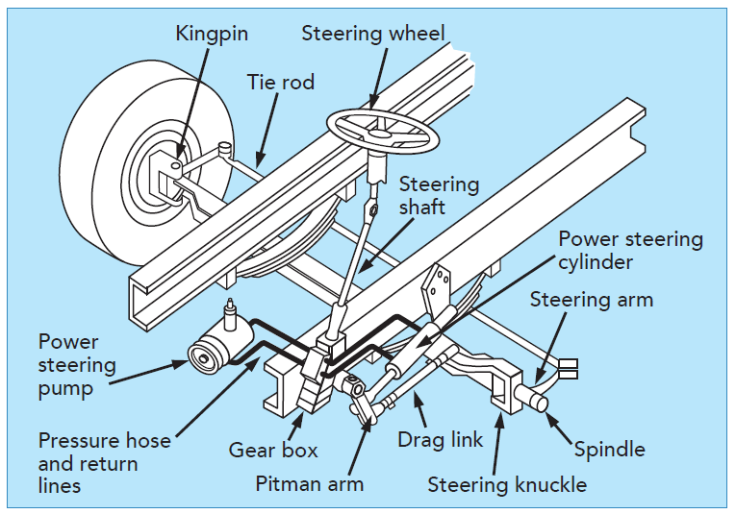
Steering system parts

Slide 26
Fuel system
The next section includes:
Fuel tanks
Fuel cap
Fuel injectors
Fuel filter
Notes:
The fuel system sends fuel to the engine. In newer models, fuel management is handled by computer.

Slide 27
Fuel systems
Fuel tank
Your truck may be equipped with more than one fuel tank. Fuel tanks come in a variety of sizes and shapes.
Fuel cap
Cover that seals onto the fuel filler neck and allows fuel to be added to the tank.
Notes:
Fuel tank:
Fuel cap: By replacing the fuel cap, contaminants are prevented from entering the fuel tank.

Slide 28
Fuel systems
Fuel injectors
Supplies fuel to the cylinders.
Fuel filter
Keeps contaminants out of the fuel system by cleaning the fuel as it flows from the tank.

Slide 29
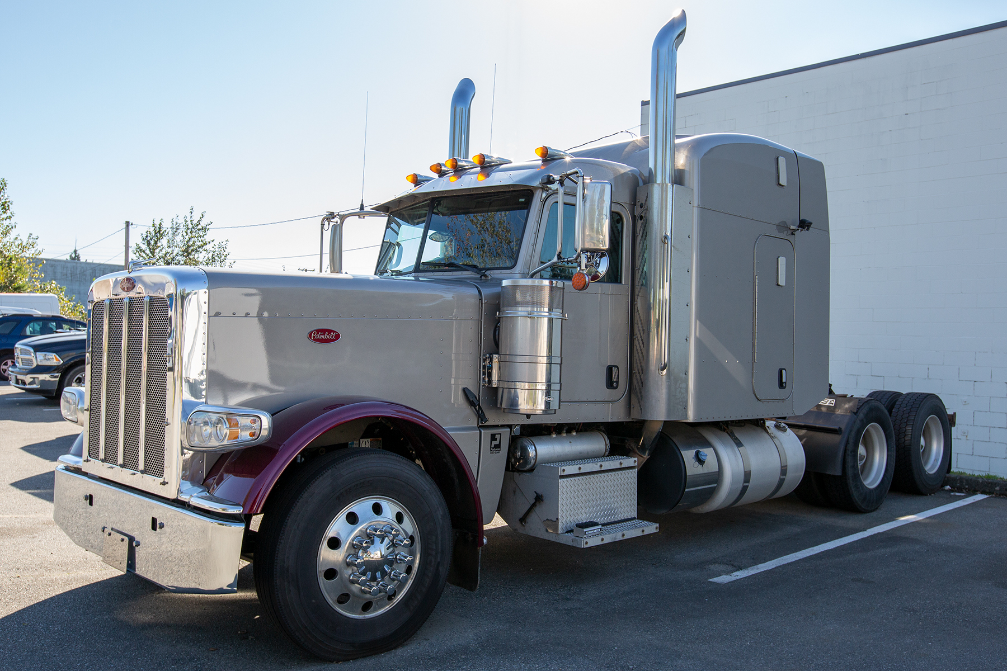
Air intake and exhaust system
The next section includes:
Air intake system
Air cleaner
Exhaust system
Turbocharger
Aftercooler
Muffler
Notes:
Air intake and exhaust systems ensure that fresh air is constantly supplied into and burned gases are expelled from the engine to enhance smooth running of the tractor-trailer.

Slide 30
Air intake and exhaust systems
Air intake system A diesel internal combustion engine is not only powered by fuel but a mixture of fuel and air. This system supplies the air that causes combustion in cylinder. It is composed of- air cleaner, turbocharger, after cooler, intake manifold, an outside air cleaner may have a rain cover or snorkel.
Notes:
Air intake system:
Aftercooler: This assists in cooling the intake air received from the turbocharger. The cooler air is also more dense, so that with the increase in oxygen so more fuel can be added resulting in more horsepower.

Slide 31
Air intake and exhaust systems
Exhaust system This system removes burned gases and fumes from the engine cylinder.
Notes:
Exhaust system: A stroke of the piston forces the burned gases to be expelled through the exhaust valves and manifolds. The gases then pass through the exhaust pipe and a muffler.

Slide 32
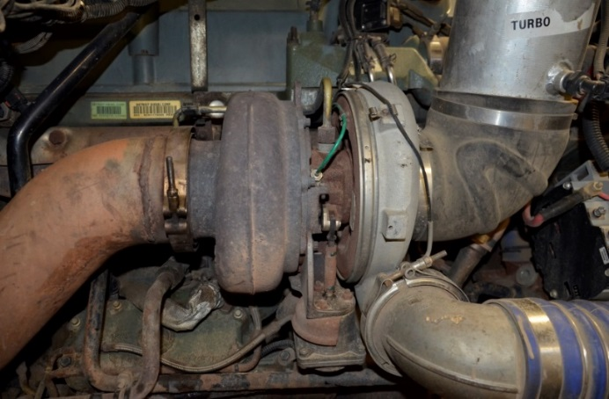
Vehicle systems
Turbocharger
Is a turbine-driven forced induction device that increases an internal combustion engine's efficiency and power output by forcing extra compressed air into the combustion chamber.
Notes:
Turbocharger
The power received from the exhaust gases are converted into power that can be used by the engine through the turbocharger

Slide 33
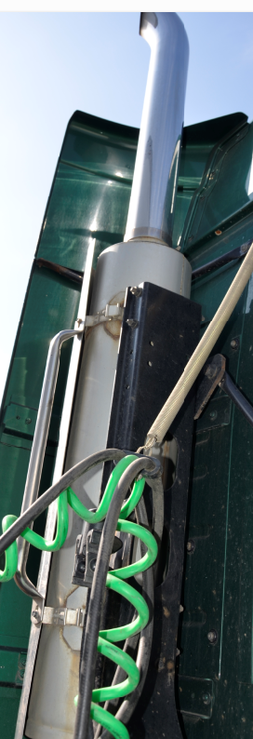
Air intake and exhaust systems
Muffler
The muffler is important in reducing the sound of the engine.
Notes:
Muffler: The muffler is important in reducing the sound of the engine.

Slide 34
Lubrication system
This is a system that distributes oil to various parts of the engine.
Oil dip stick
Oil filter
Notes:
The presence of oil in enables the moving parts to slide smoothly instead of rubbing together, thereby reducing friction between the surfaces of the engine parts.

Slide 35
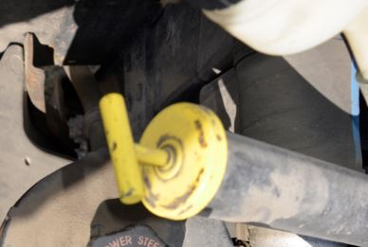
Lubrication system
Oil dip stick Is used to indicate the level of oil in the engine.

Slide 36
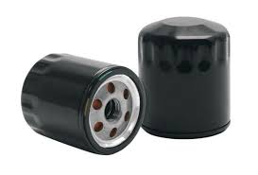
Lubrication systems
Oil filter As the oil circulates to cool the engine and reduce friction between the engine parts, it collects dirt, grime and bits of metals which must be removed before causing damage to the engine The oil filter strains out these impurities before they circulate to all the moving components.
Notes:
Oil filter:.

Slide 37
Coolant system
The next section includes:
Thermostat
Radiator with coolant
Radiator cap
Hoses and clamps
Fan belt

Slide 38
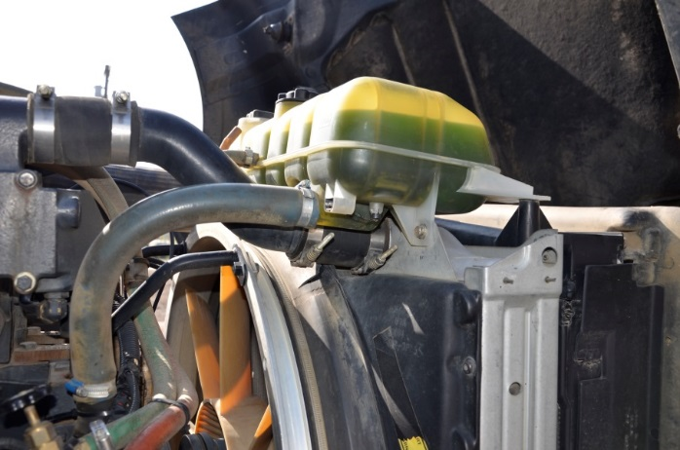
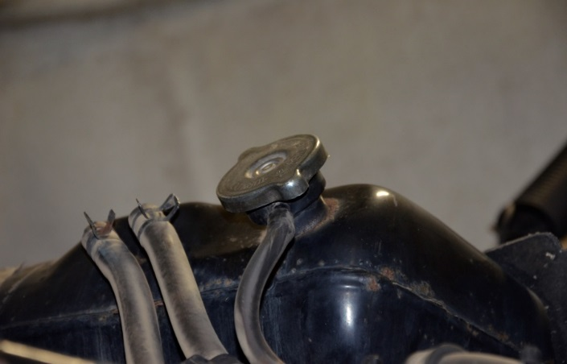
Coolant system
Radiator A vehicle cooling system keeps the temperature constant to prevent intense heat from damaging the vehicle engine. Radiator cap This seals the radiator.
Notes:
Radiator: The radiator is the largest part of the cooling system. It is a reservoir that assists in cooling the engine through heat exchange. It consists of the upper and lower tank, the core, the tube, connection for hoses and a filler cap
Radiator cap: The cap assists in maintaining the pressure on the coolant. This should be removed only when the engine is cold.

Slide 39
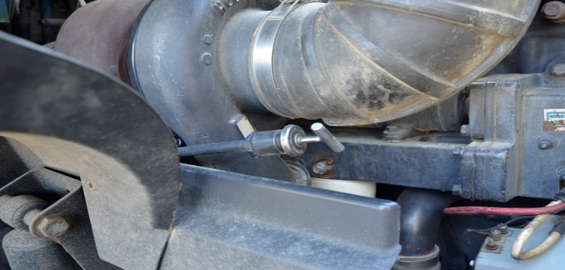
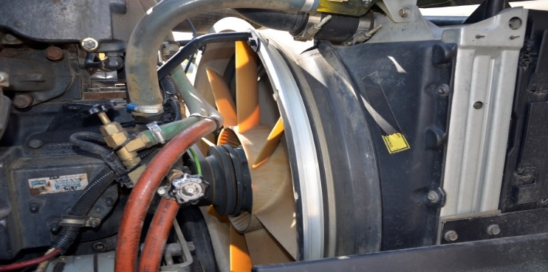
Coolant system
Applicable hoses and clamps Hose clamps are used to attach a hose to a fitting. Hoses are used to convey fluid or air from one part of the engine to another.

Slide 40
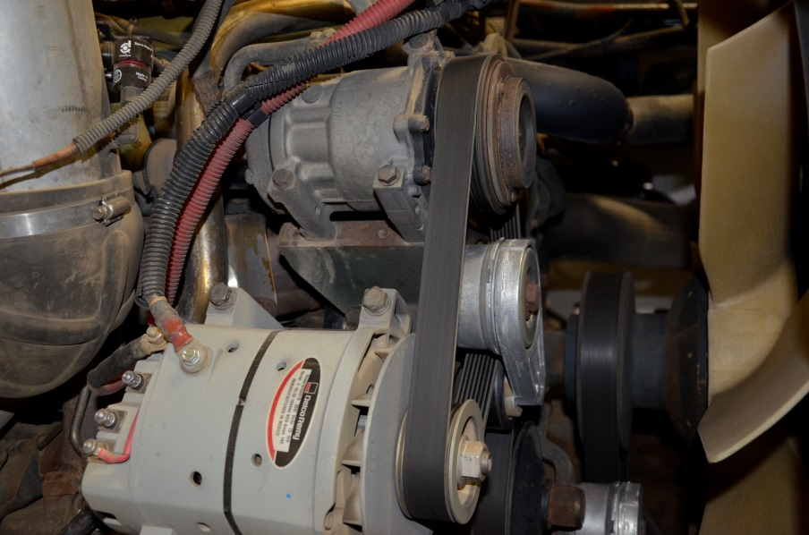
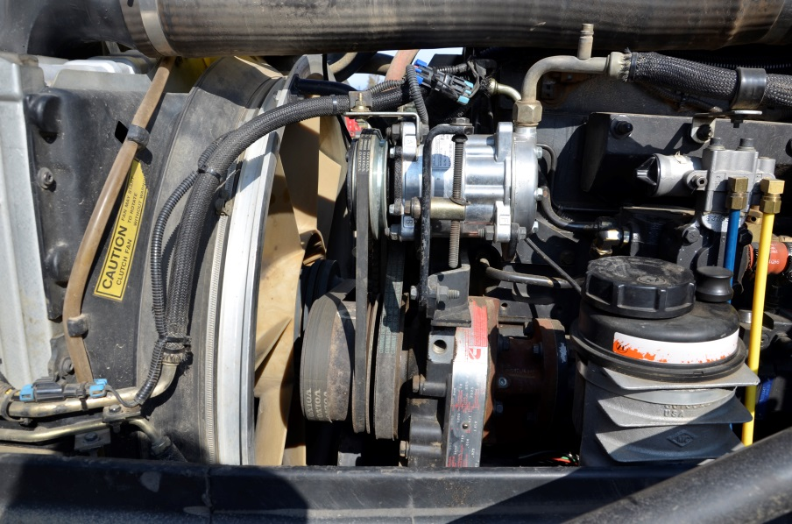
Coolant system
Fan belt and blades A belt that drives the fan and the alternator. This must be inspected for tension / wear and replaced as needed.
Notes:
Newer vehicles come with serpentine belts and auto tensioners.

Slide 41
Electrical system
The next sections includes:
Battery
Alternators
Voltmeter
Ammeter
Notes:
The electrical system is complex and needed to start your engine, run your lights and utilize your instruments and gauges.

Slide 42
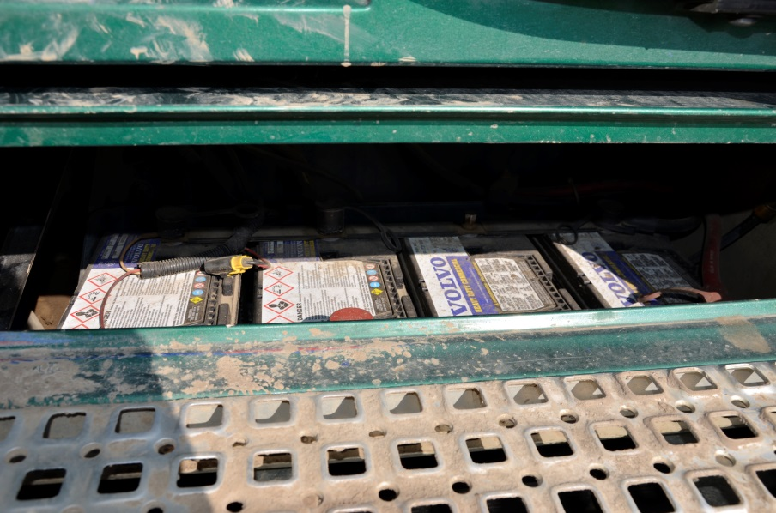
Electrical system
Battery and battery cable A battery stores energy to supply power to the vehicles electrical system Battery cables are connected to the terminals to transport electricity to the starting system
Notes:
Battery and battery cable: Component of the electrical system. The battery has a positive terminal and a negative terminal. The terminals are usually located on the top of the battery.
The battery must be securely mounted. Some vehicles are equipped with night switches, battery shut off.

Slide 43
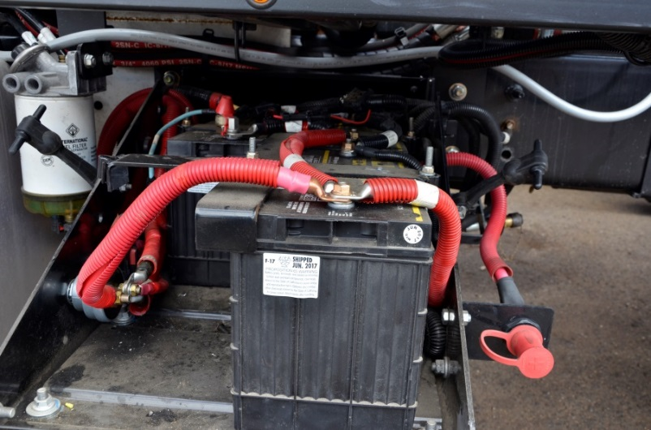
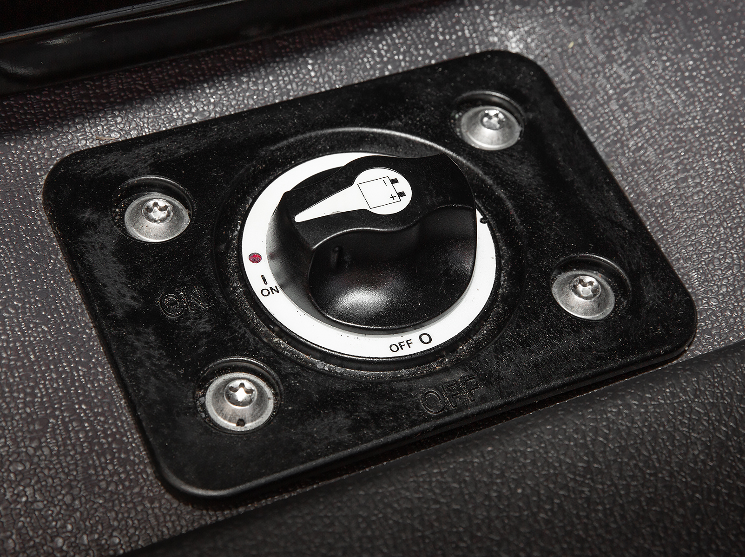
Electrical system
Notes:
Wires: Component of the electrical system. These are used to connect the electrical components of a vehicle. Wires carry the energy required to activate a vehicle’s electrical components and devices e.g. lights, doors, locks, windows etc. Wire connections should not be exposed.

Slide 44
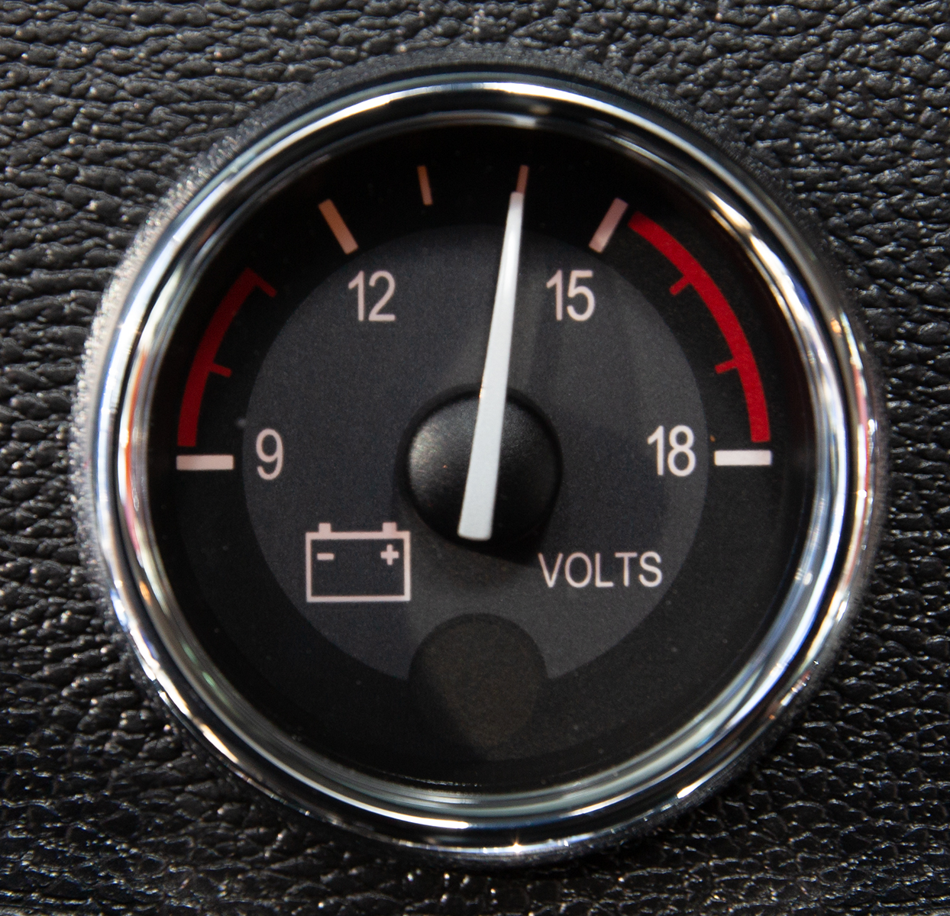
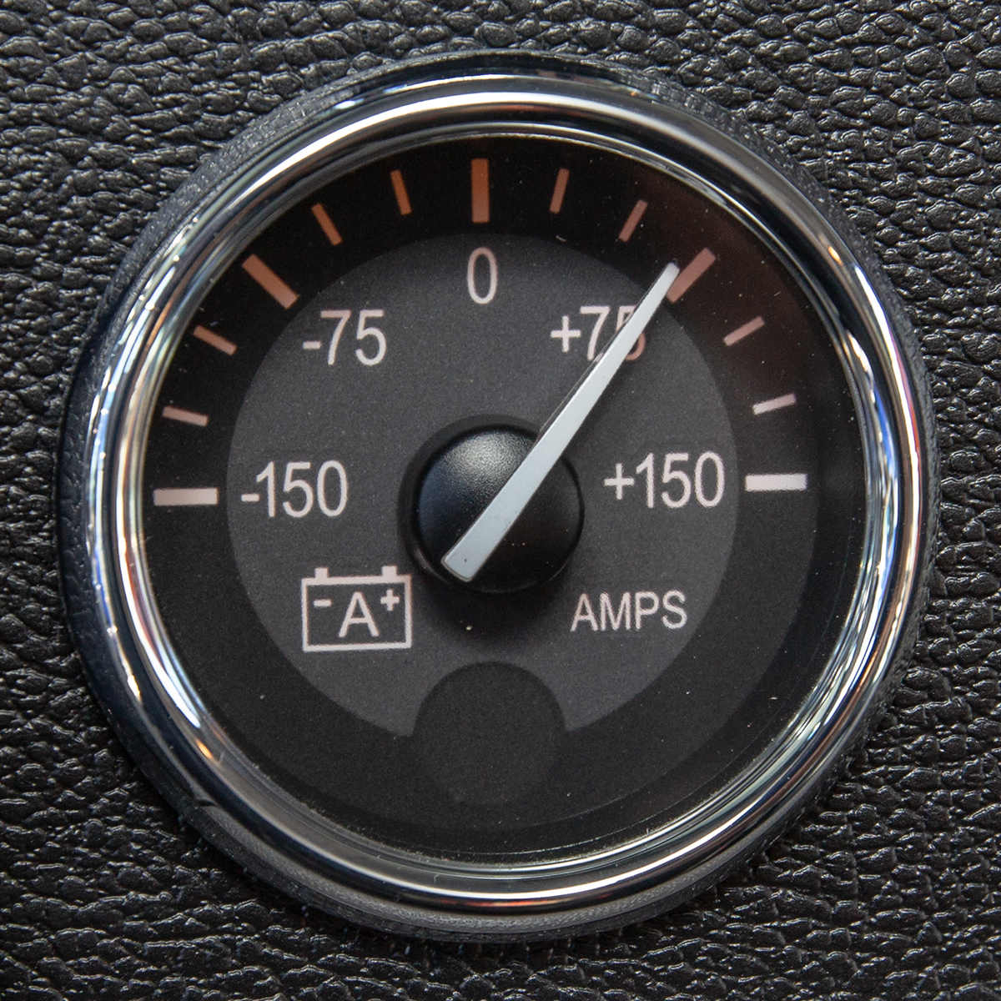
Electrical system
Volt Meter Amp Meter
Notes:
Volt Meter: Component of the electrical system. Measures the stored voltage in your batteries when you first turn the ignition on, should read 12 volts or greater. Once your engine is started the volt gauge will show you the voltage that the alternator is charging the batteries at. Should be between 12.75 and 14 volts. If it is reading too high or too low you should bring it to the attention of your maintenance department. Some newer trucks have the volt meter built in to their electronic dash displays.
Amp Meter: Shows whether the alternator is putting out enough power to meet the needs of your electrical system. It should read 0 or on the plus side of the gauge. If the gauge shows a negative number it may indicate an overloaded electrical system or a failing alternator, if it continues you should bring it to the attention of your maintenance department.

Slide 45
Brake system
The next section includes:
Disc brake
Drum brake

Slide 46
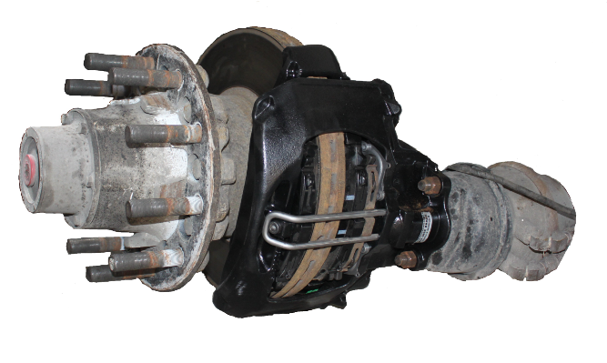
Brake system
Disc brake The components of a disc brake system consist of a disc and calliper. When the brakes are applied, the calliper squeezes the disc creating friction and slowing the vehicle.

Slide 47
Brake system
Drum brake This is a drum attached to each side of the axle by bolts, to stop or slow down tire rotation when the driver applies pressure on the brake pedal.
Notes:
Drum Brake: This is a drum attached to each side of the axle by bolts, to stop or slow down tire rotation when the driver applies pressure on the brake pedal. When brake is applied friction is created when the brake shoe linings are forced against the inside of the brake drum.

Slide 48
Brake system
Air brakes use pressure from compressed air to increase braking force for both tractor and trailer Heavy vehicles require a more complex and powerful braking system than ordinary vehicles Detail on air brakes will be covered in the air brakes unit.

Slide 49
Tires and wheels
The next sections includes:
Wheels
Tires
Wheel hub
Wheel bearing
Wheel rim
Wheel fasteners

Slide 50
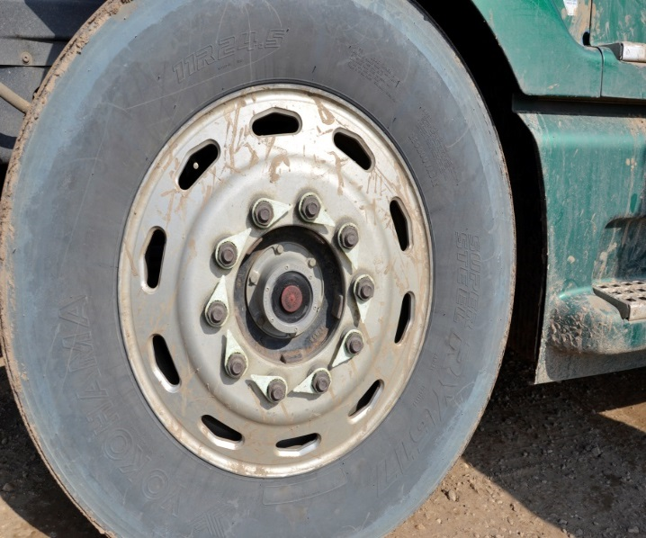
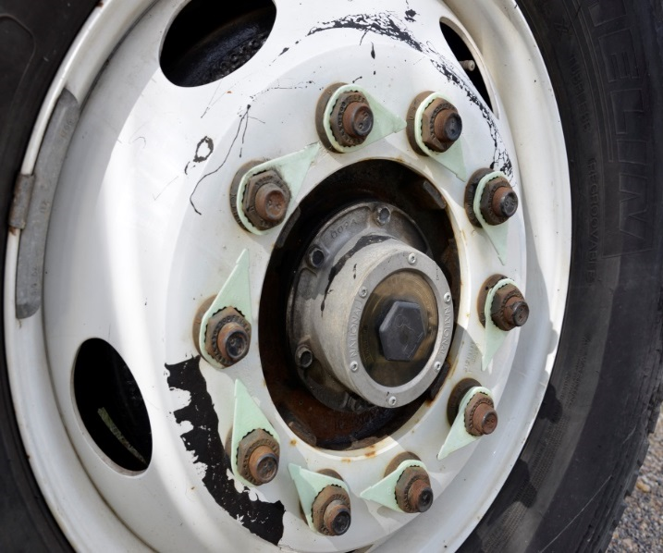
Tires and wheels
Wheel hub The hub is used to connect the wheel to the vehicle. Wheel bearing Is a set of steel balls held together by a metal ring called a race. They help wheels spin with as little friction as possible
Notes:
Tire: Driver must ensure that tires are inflated correctly. Underinflated tire builds up heat as it travels over the road surface. This may damage the tire casing and can explode if it gets too hot.

Slide 51
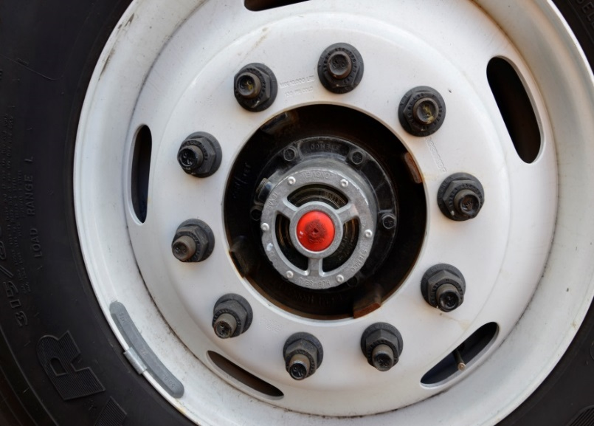
Tires and wheels
Wheel rim Is a single assembly used for mounting large tires on trucks and trailers. Wheel fasteners A lug nut or wheel nut is a fastener, specifically a nut, used to secure a wheel on a vehicle.
Notes:
Wheel rim: This is a single assembly used for mounting large tires on trucks and trailers.
Wheel fasteners (Nuts, bolts and studs): A lug nut or wheel nut is a fastener, specifically a nut, used to secure a wheel on a vehicle.

Slide 52
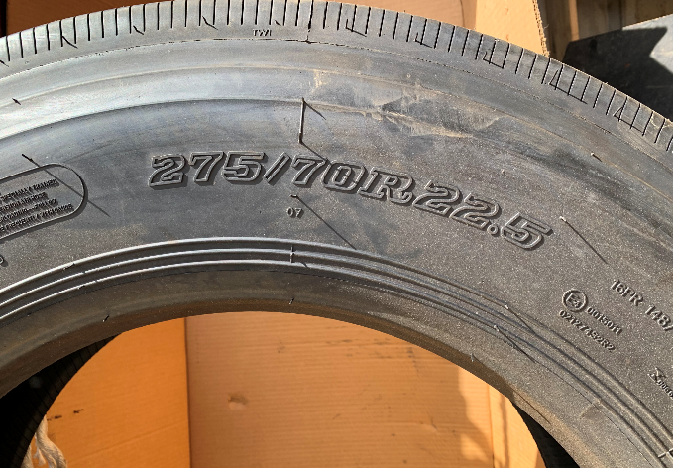
Tires and wheels
Reading the sidewall
Notes:
Low profile tire – 275 millimeters tire width
Aspect ratio is 70% of the width
R means Radial tire
22.5 is the diameter in inches of the wheel that the tire fits on to

Slide 53
Coupling system
The next section includes:
Fifth wheel
Kingpin
Pintle hitch
Landing gear
Notes:
These are vehicle components used to connect a tractor to a trailer. This system has two main components- the fifth wheel and the trailer kingpin.

Slide 54
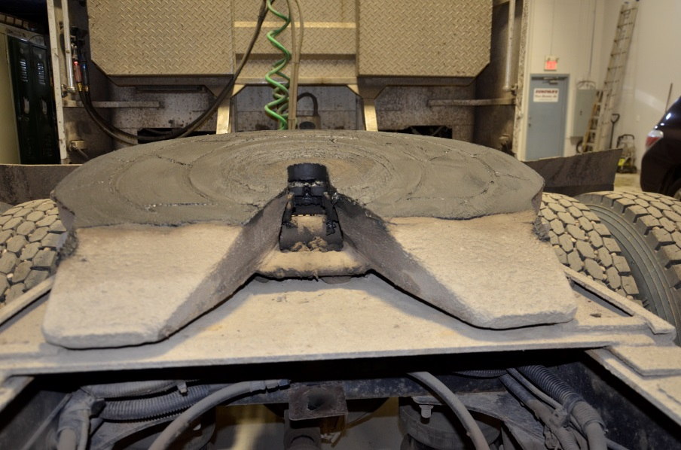
Coupling system
Fifth wheel Is a coupling device that is mounted on the vehicle chassis and that consists of a skid plate, associated mounting brackets and latching mechanism that couples or connects to a kingpin located on the other vehicle or component, for the purpose of supporting and towing a semi-trailer.
Notes:
There are two types of fifth wheels, the stationary and the sliding fifth wheel.
A stationary fifth wheel is mounted on the frame rails of the tractor and is positioned in a way that the optimum weigh distribution is achieved between the front and the rear axles of a properly loaded trailer.
The sliding or adjustable fifth wheel can be adjusted back and forth along the frame rail in a way to ensure even weight distribution on each axle.
The sliding fifth wheel can adjust the overall length of the tractor-trailer and hence, the turning radius of the vehicle.

Slide 55
Coupling system
Trailer kingpin
Is usually a 2–inch high-strengthened steel pin that fits and locks into the jaws of the fifth wheel to couple the tractor to the trailer.

Slide 56
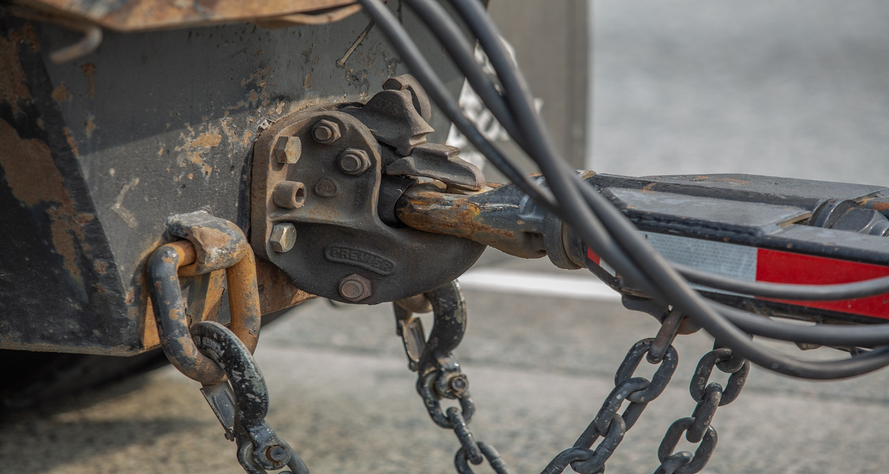
Coupling system
Pintle hitch
Is a type of tow hitch that uses a ring-to-hook configuration for a more secure mount that's ideal for rougher terrain.

Slide 57
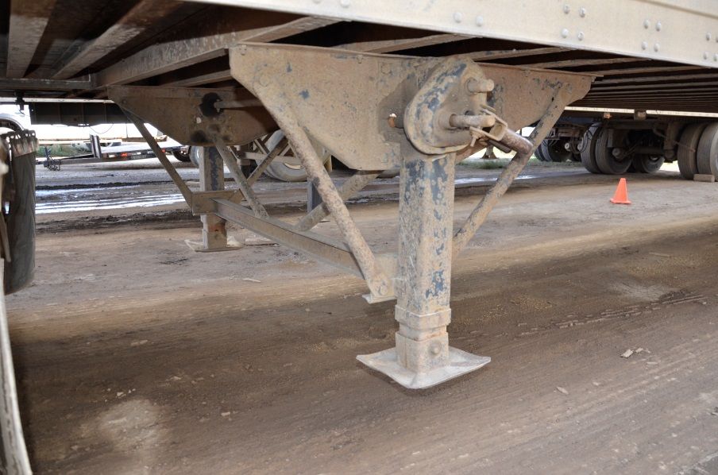
Coupling system
Landing gear Provides stationary support for the front of a trailer when it is not coupled to a tractor.
Notes:
Landing gear:

